Slide 1
All Agency Relations Conference
How to Elevate the Pantry Environment
Notes:
Good afternoon everyone and welcome to the Nutrition Services presentation on How to Elevate the Pantry Environment. My name is Tiffany Virgen and this is Nohemi Lopez. We are both health educators with the Nutrition Services Team at the Los Angeles Regional Food Bank.

Slide 2
Housekeeping
Questions
Restroom and exits
Activity Overview
Material
Food Demo
Take Home Packet
Refrain from opening until the end
Notes:
Before we get started with our presentation, here are a few housekeeping items we want to go over with you all:
We will have time for questions at the end of the presentation.
Please save your questions until then
We will also have a survey for you to provide feedback and comments as well
Restroom and exits are located (tbd)
2 finger point or Barbie hands
Activity Overview:
We will be providing you all with materials to conduct fun activities
At each of your tables there are two manila envelopes (1 person lifts up to display). Each envelope contains items and instructions.
Please do not open until we tell you to.
Afterward please put the materials back in the folder
We will conduct a food demo.
We will have infused water for you to enjoy at the end of the demonstration
Take Home Packets:
We have fun packets (lift up the incentive packet) for you all to take home and apply what you learned here today at your pantry!
Please do not open the packets until the end of the presentation
We will go over all the materials in your packet throughout the presentation

Slide 3
Agenda
Introduction
Nutrition Services Overview
Nutrition Pantry Program Overview
Environment
Activity #1
Nudging and Bundling/Best Practices
Nutrition Education
Activity #2
Food Demo/Best Practices
Closing
Notes:
Here is the agenda. Today we will start with an overview of our department and the work we do as a team. Then we will be giving you tips on how you can incorporate simple changes at your pantry to enhance the customer’s experience. We will also be showcasing simple, single ingredient food demos that you can try at your distribution as well as best practices to guarantee success. Let's get started.

Slide 4
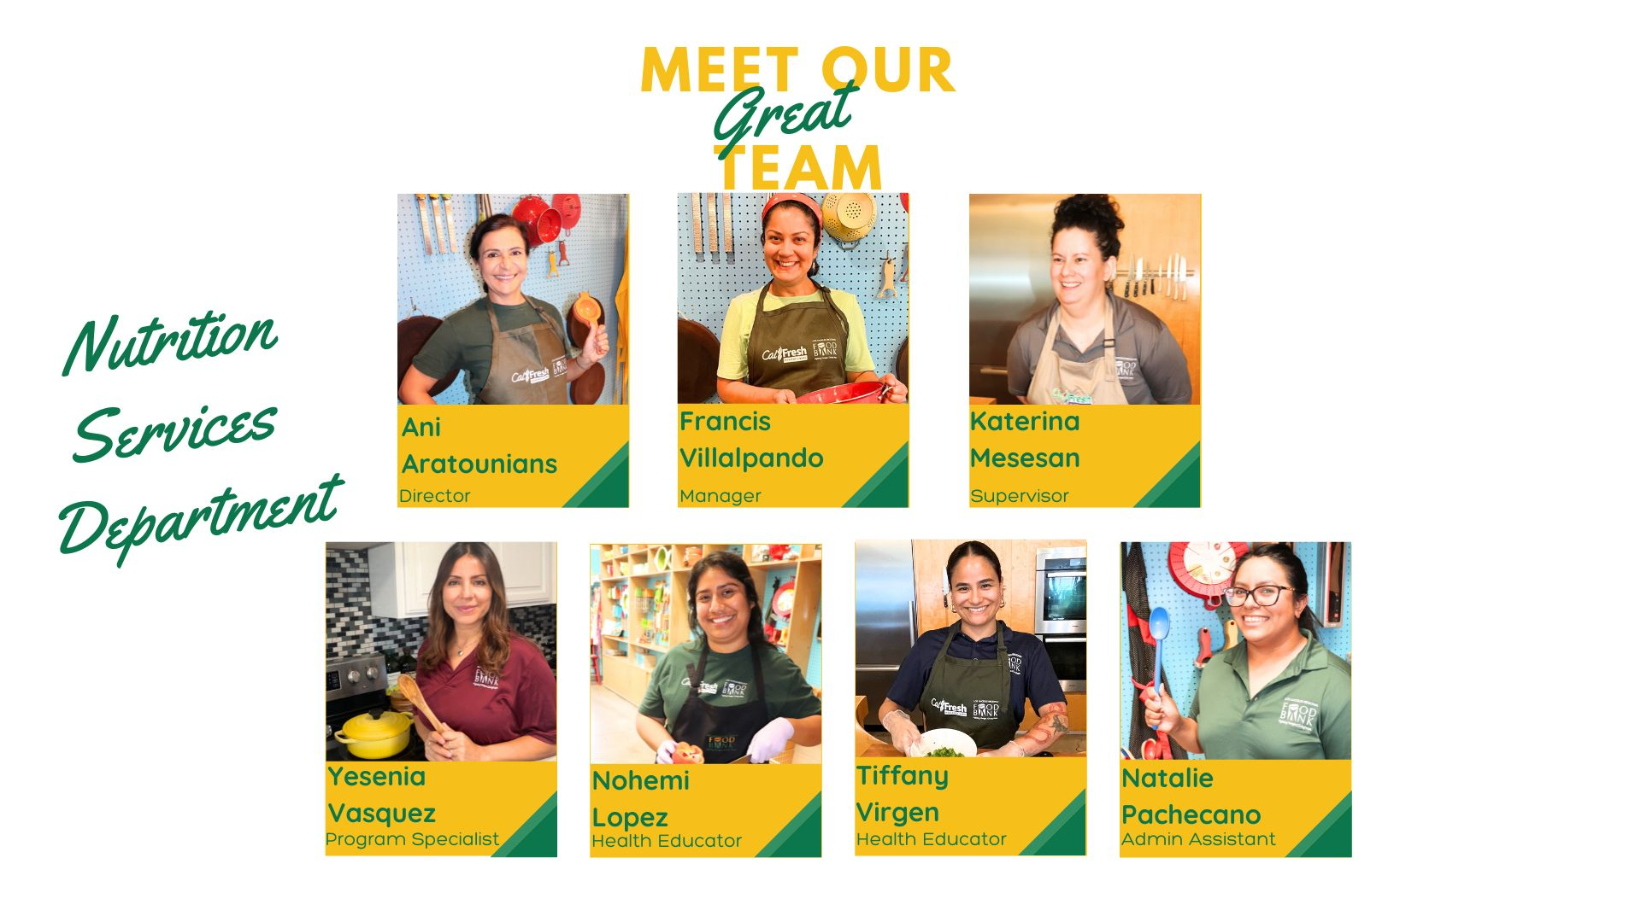
Notes:
Our wonderful Nutrition Services team consists of our director Ani Aratounians, our manager Francis Villalpando, our supervisor Katerina Mesesan, our program specialist Yesenia Vasquez and our admin assistant Natalie Pachecano.

Slide 5
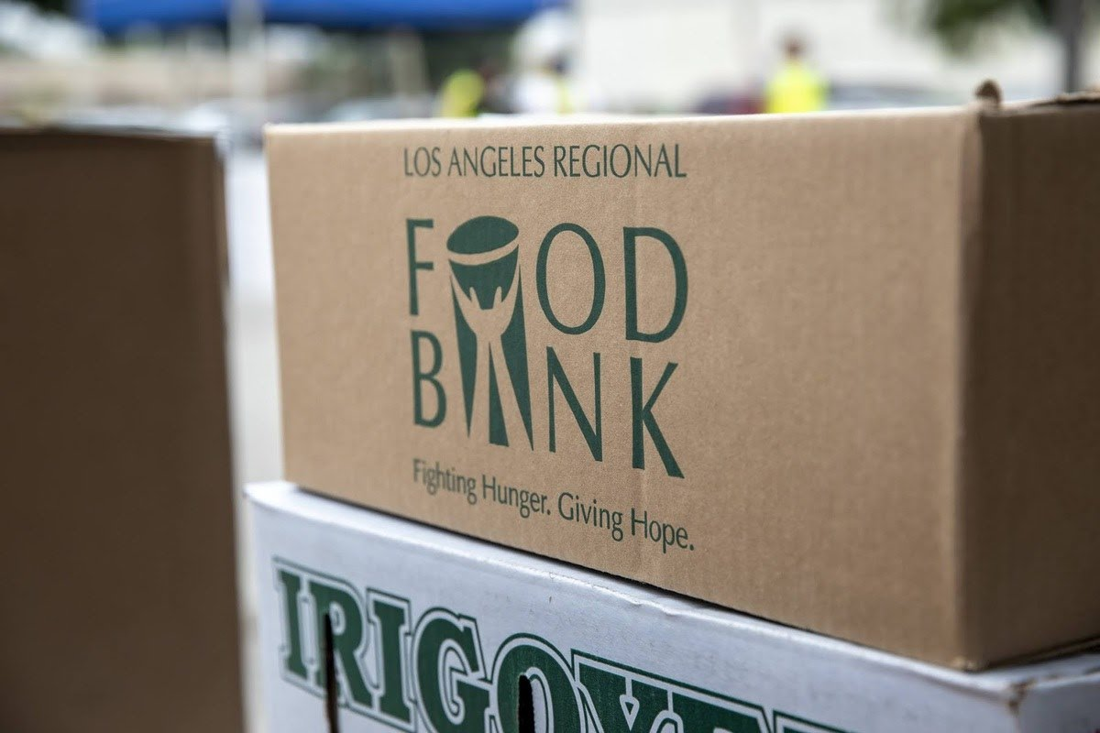
Nutrition Services Overview
Fight Hunger
Empower People
Promote Health
Notes:
Since 2020, the Nutrition Services Department supports the efforts of the LA Regional Food Bank to distribute high-quality, nutritious and culturally appropriate food to end hunger in our communities.

Slide 6
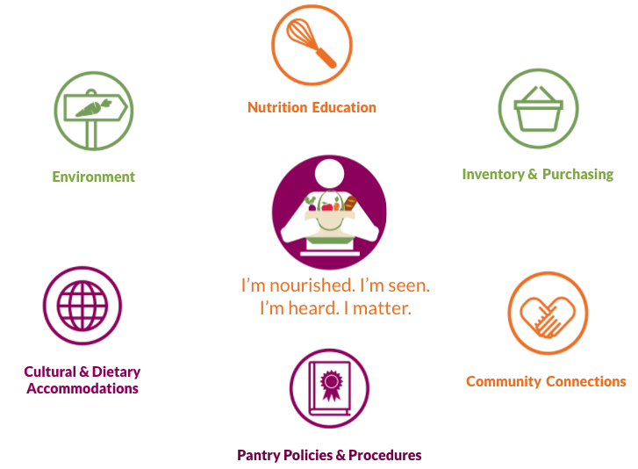
Nutrition Pantry Program Overview
The Nutrition Pantry Program (NPP) provides a process for implementing practical, client-centered strategies for a health-focused environment in all types of food distribution sites. It’s created by Leah’s Pantry based on 6 focus areas.
Notes:
As a team we implement and provide technical support through the Nutrition Pantry Program (NPP) when we work with our pantry partners. Created by Leah's Pantry, NPP is about making great pantries greater. It focuses on elevating the pantry environment so customers feel seen and nourished through 6 focus areas. (point to the Focus Areas infographic)
The 2 we will be discussing in detail today are nutrition education and environment.

Slide 7
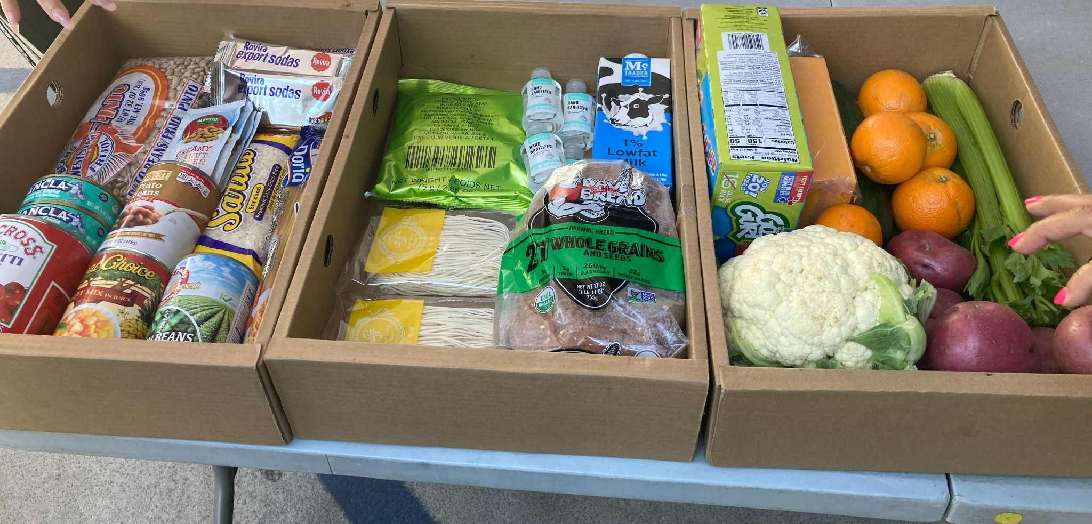
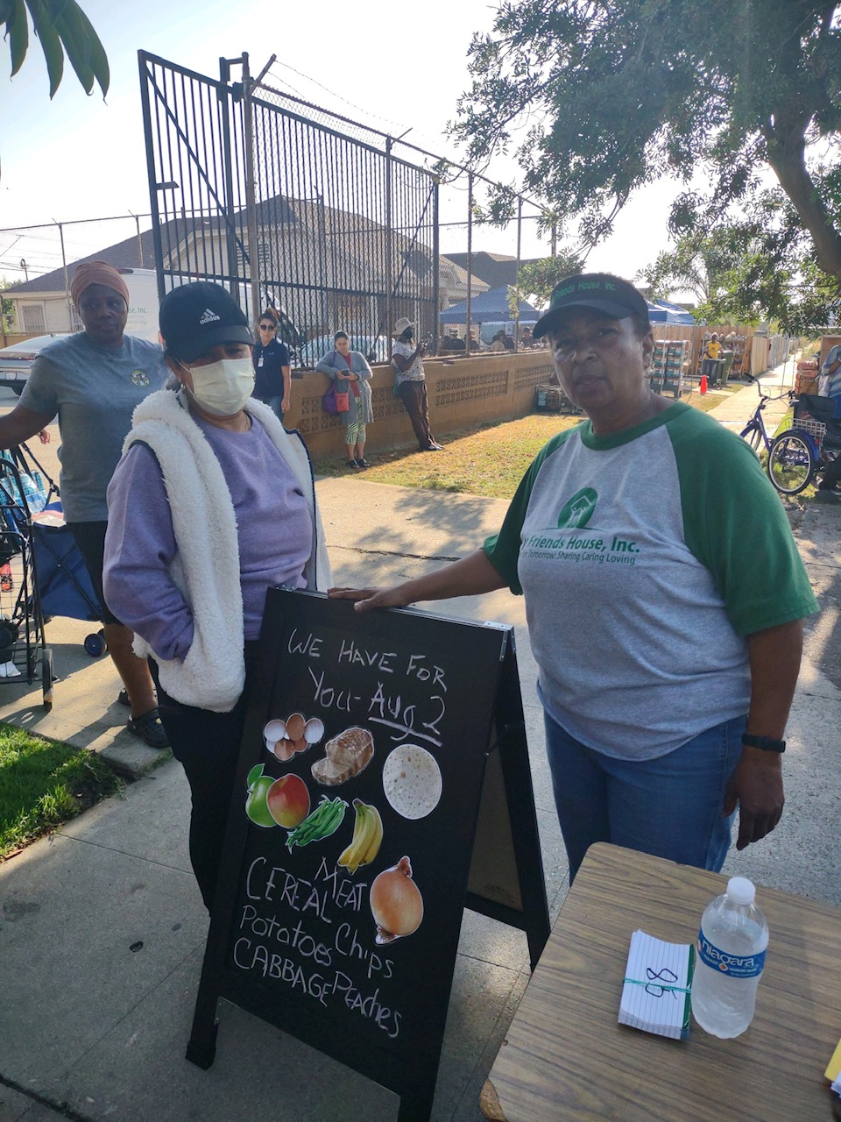
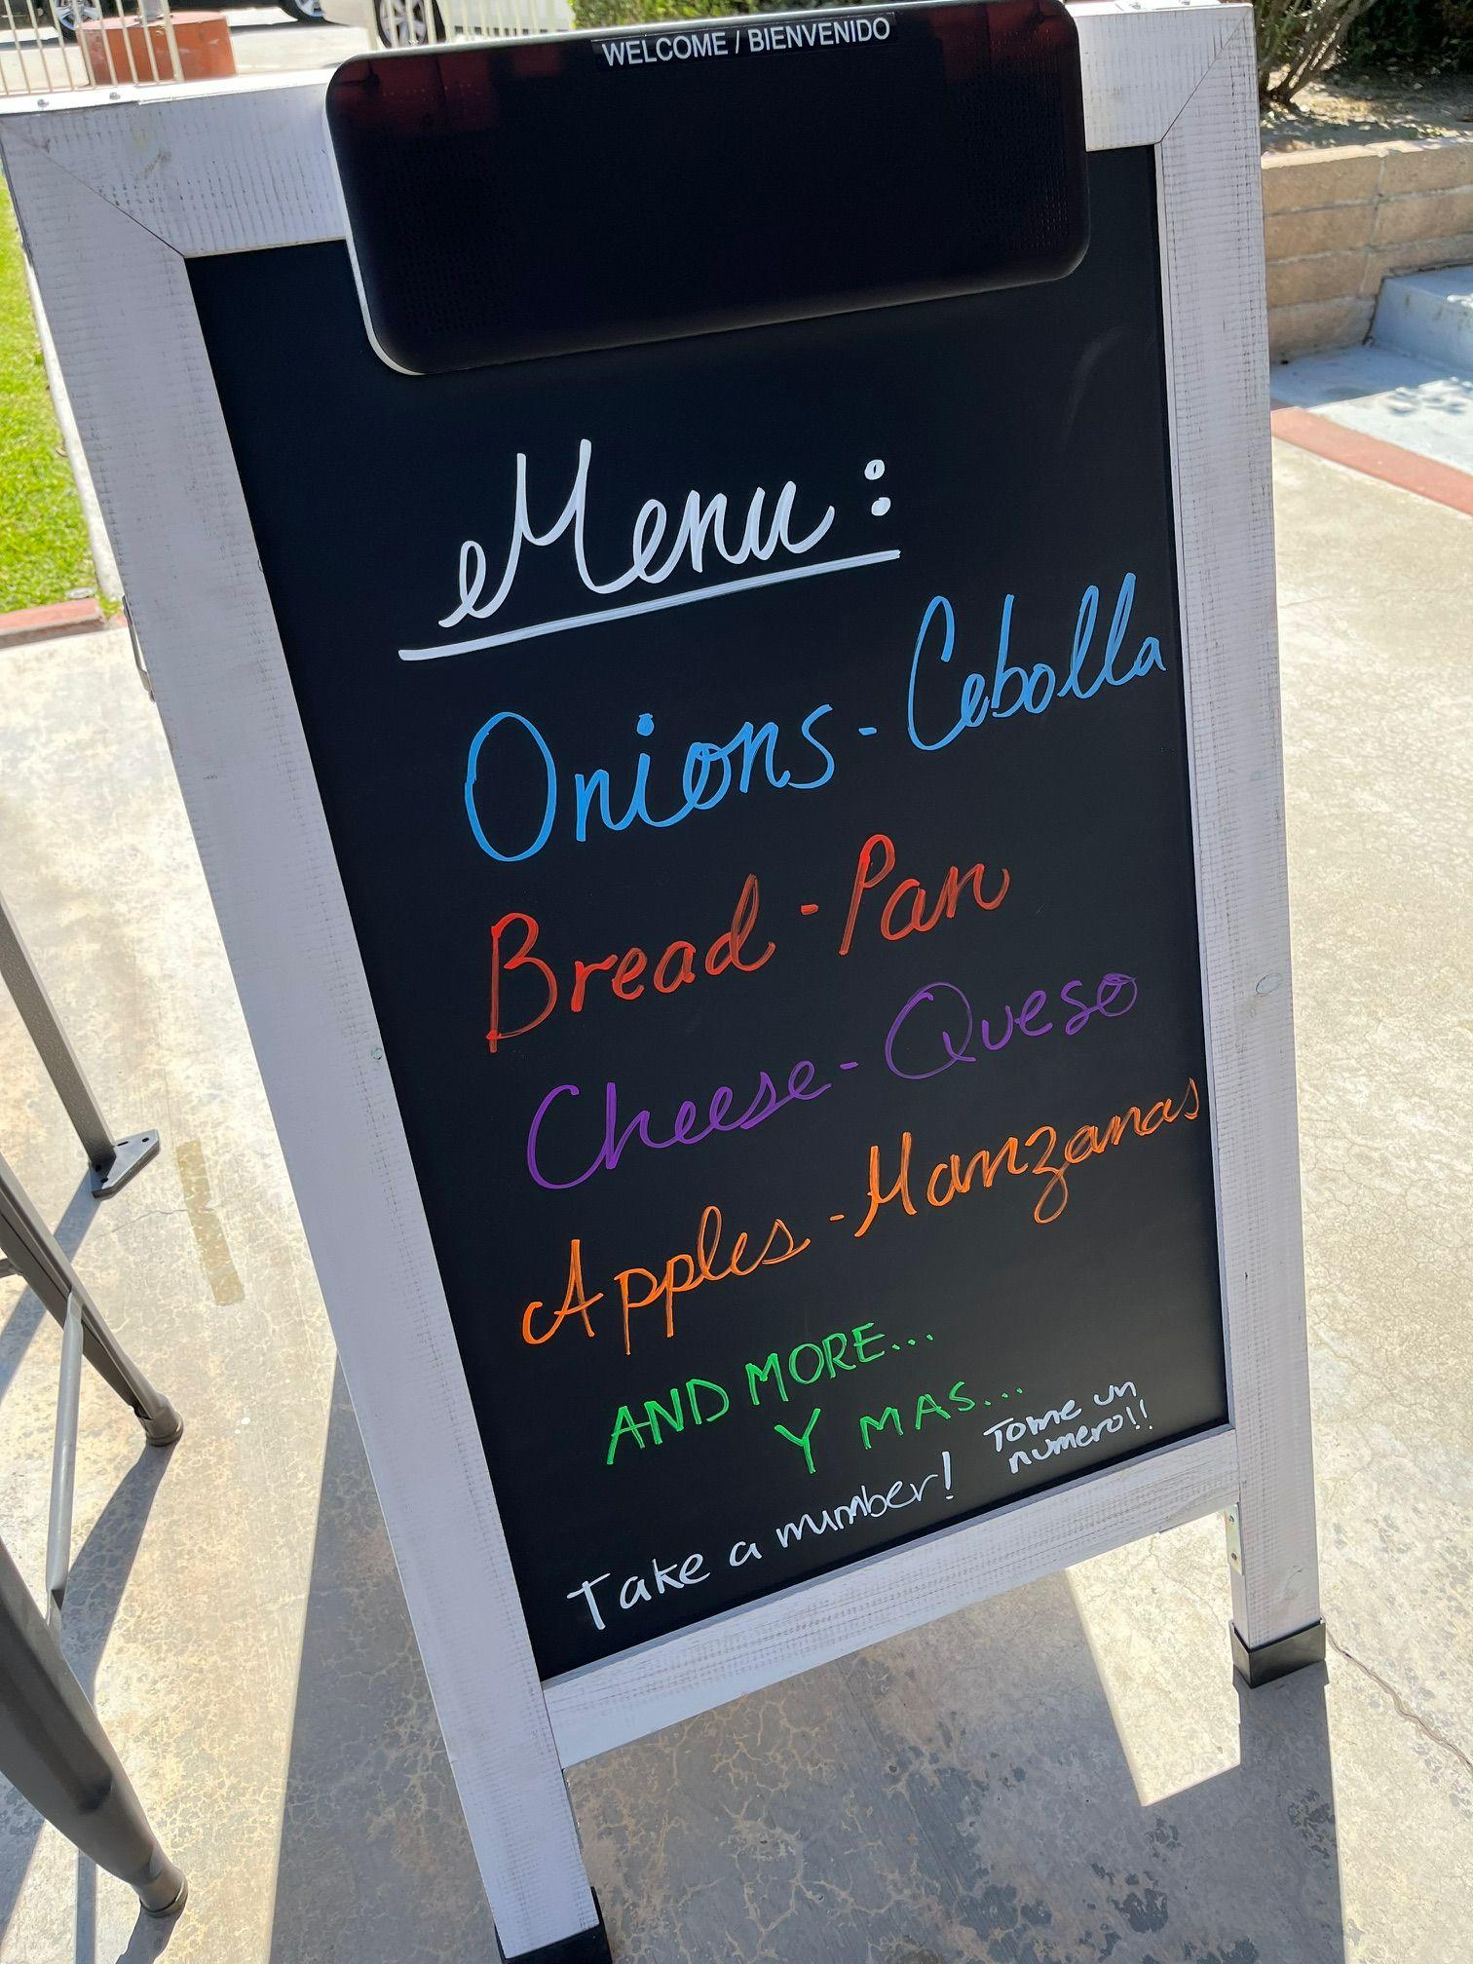
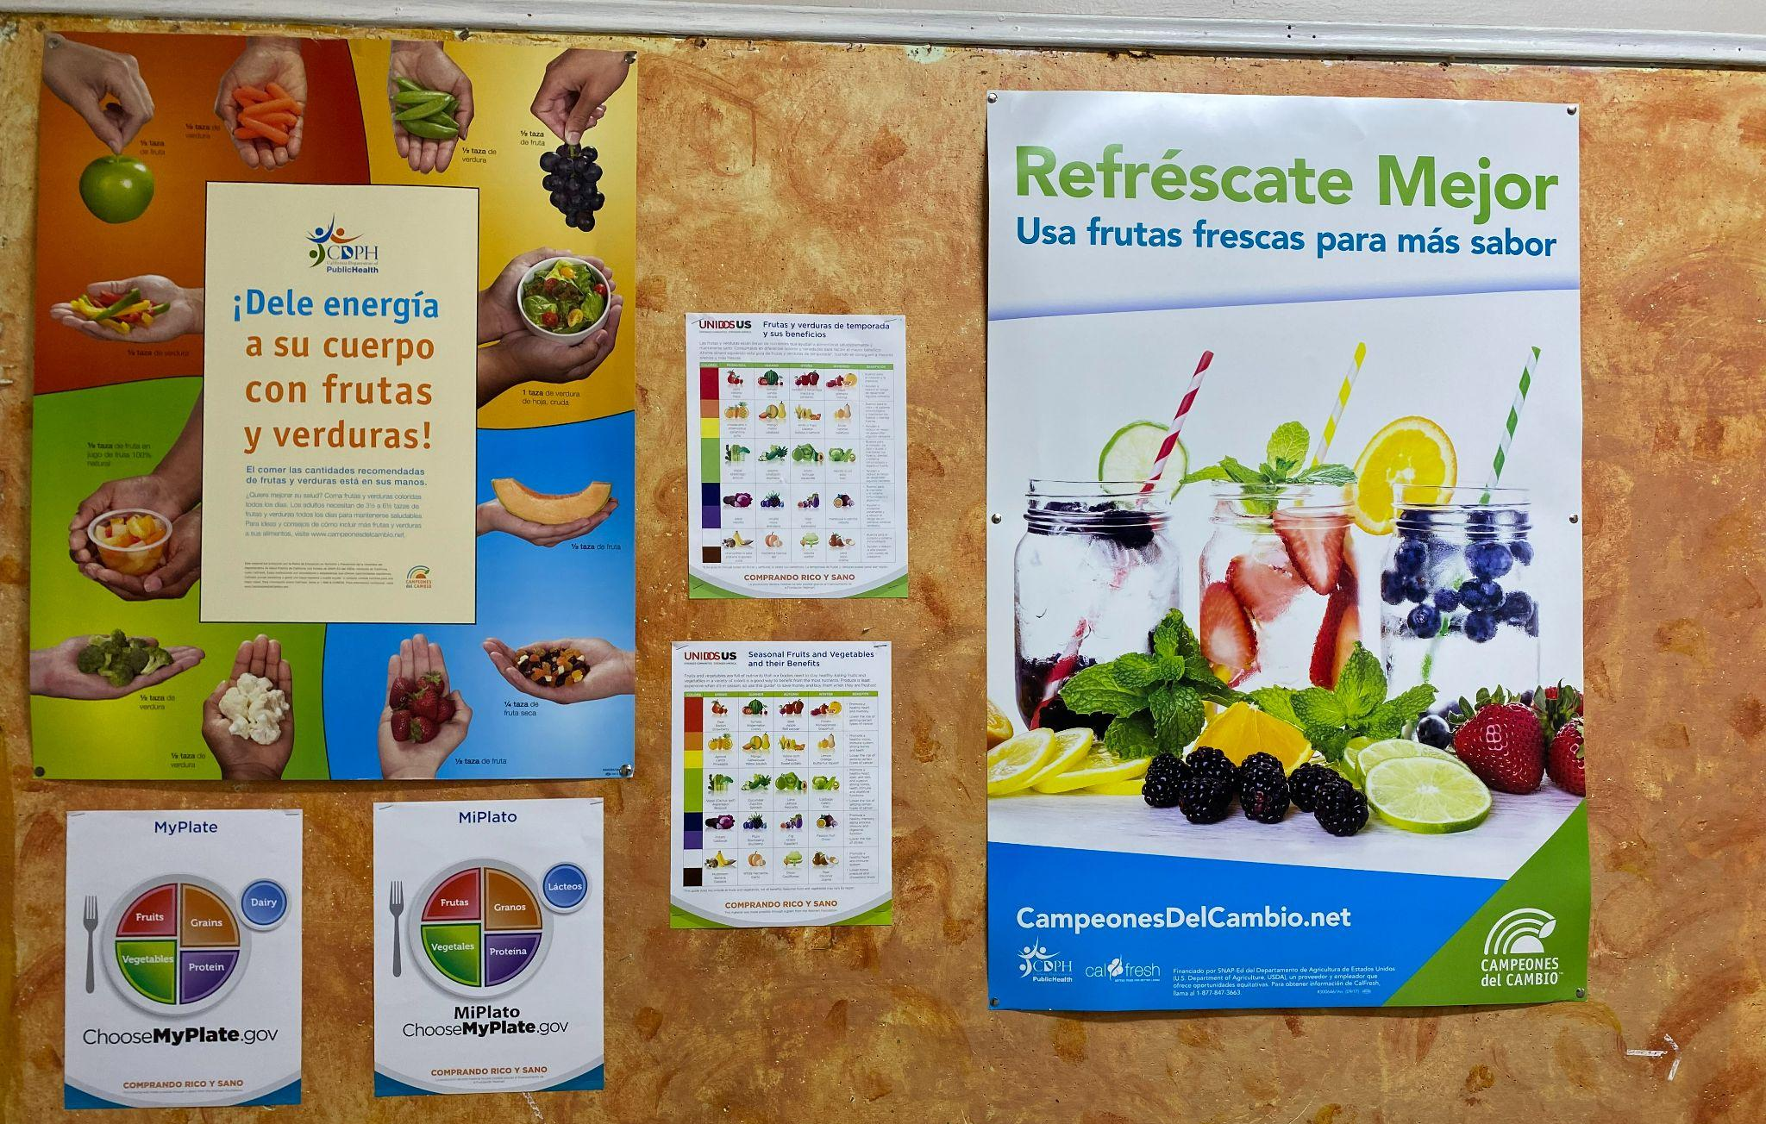
Environment
Central City Neighborhood Partners
My Friend’s House
Whittier SDA Church
Eastmont Community Center
Notes:
First let’s talk about Environment. Environment refers to the physical environment at a food distribution. What does it look like and how does it make customers feel? Are there opportunities to liven up the space? Are customers warmly welcomed? Are healthy options easy to access?
The Environment of your pantry can uplift and motivate an individual, or it can add to the trauma, stigma and shame associated with food insecurity. Out of all the key focus areas in NPP, Environment is the most visible and can have an immediate impact.
The pantries photographed on this slide were able to make small modifications to add a more personal touch to their distributions. Some of these modifications included adding nutrition education posters (like East Community Center did), writing out a menu of items being distributed that day (just like Whittier SDA Church and My Friend’s House) or simply creating a display of foods being received (just like Central City Neighborhood Partners). All of these are changes that were made based on the pantries’ capability and capacity.
Today we are going to present hands-on best practices and provide resources for you to enhance the pantry experience for your customers.

Slide 8
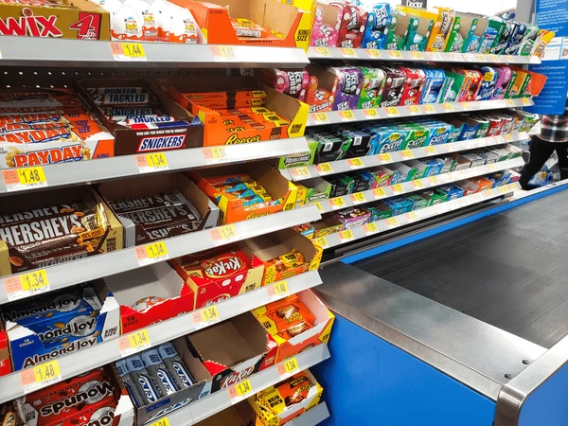
Nudging and Bundling
Notes:
Have any of you ever been tempted to grab a candy bar at the grocery checkout?
That’s because products have been strategically placed for us to be influenced to take them. In the pantry setting we can apply these concepts to help customers make healthier choices. That practice is called Nudging.

Slide 9
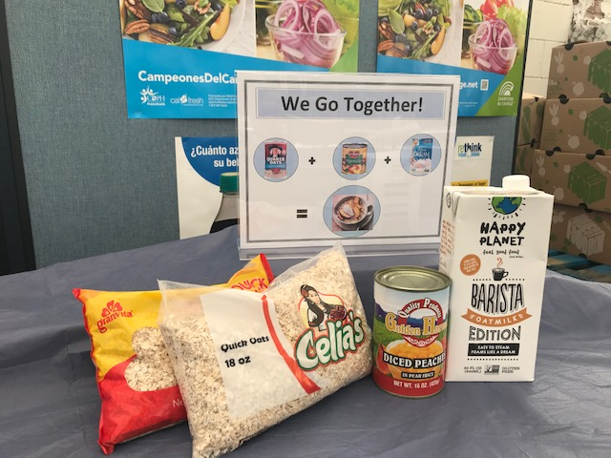
Nudging and Bundling
Nudging is the act of creating small changes in an environment to influence behaviors without eliminating choice.
Bundling is the act of providing simple snack or meal ideas by displaying pantry ingredients that go together.
Jewish Family Services
Notes:
Nudging is a great way to encourage behavior change without forcing it upon people. In a pantry setting, we can nudge people towards more healthier options through best practices like:
Making healthy foods accessible at the beginning of the distribution. If you place fruits and vegetables before other foods in line, customers are more likely to take them. If you use racks, place healthy options at eye level.
Making healthy foods attractive by using tablecloths, colorful display baskets or bins instead of cardboard boxes. If possible, add a sample to entice customers.
Pick through any produce that doesn’t look good before putting it out for customers. And keep replenishing foods to give the impression of abundance at all times.
You can also practice Bundling by grouping together products at the distribution that go together to reduce waste and to give your customer’s ideas about how to cook the food at home. Just like Jewish Family Service in this photo.

Slide 10
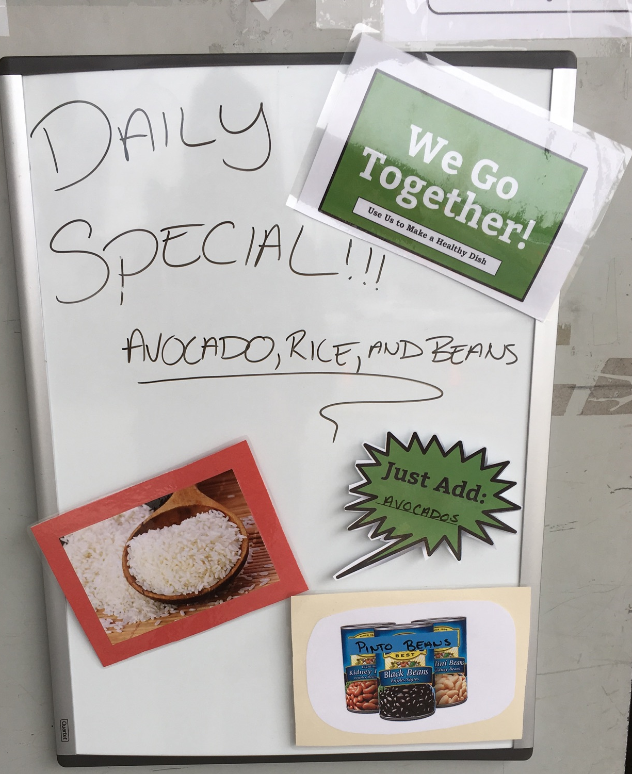
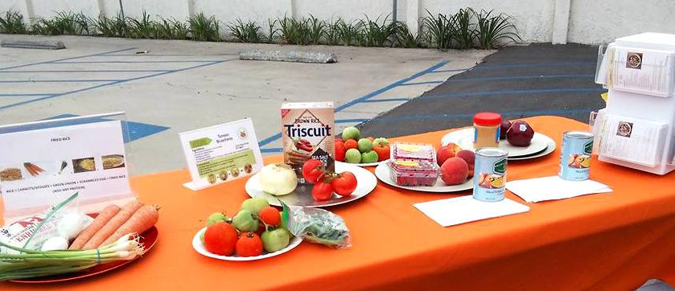
Other Examples
Leah’s Pantry
Notes:
As you can see in these images from Leah’s Pantry, the photograph on the left is highlighting ingredients and specials of the day while suggesting they can be bundled together to make a healthy meal. The image on the right, there is a recipe card for customers to take home and cook a delicious meal for their families. Not only are you creating a welcoming environment, but you’re also promoting healthy foods.

Slide 11
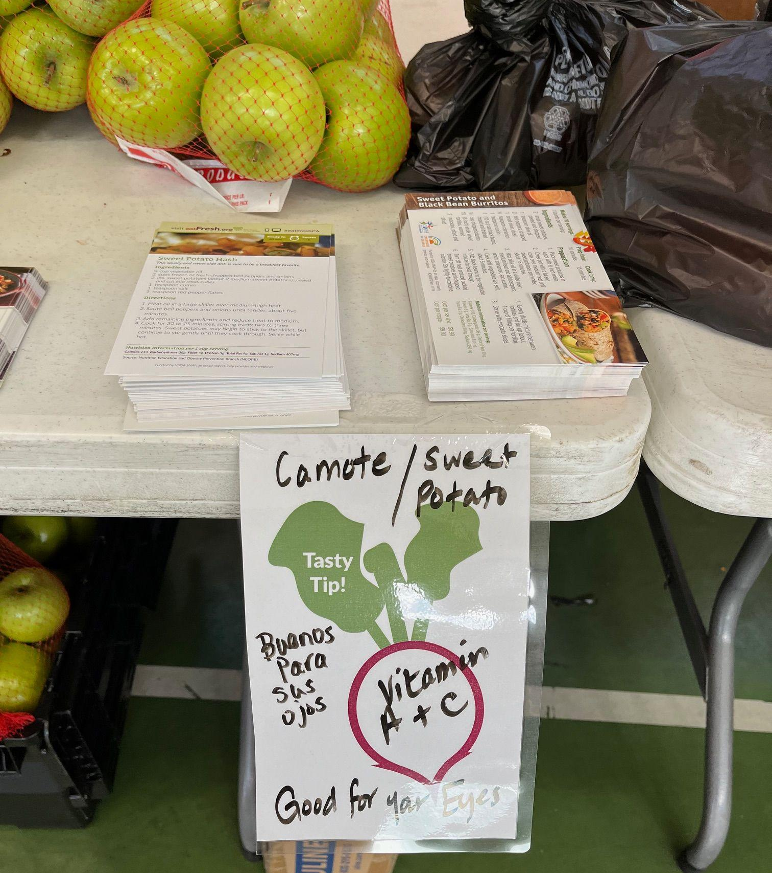
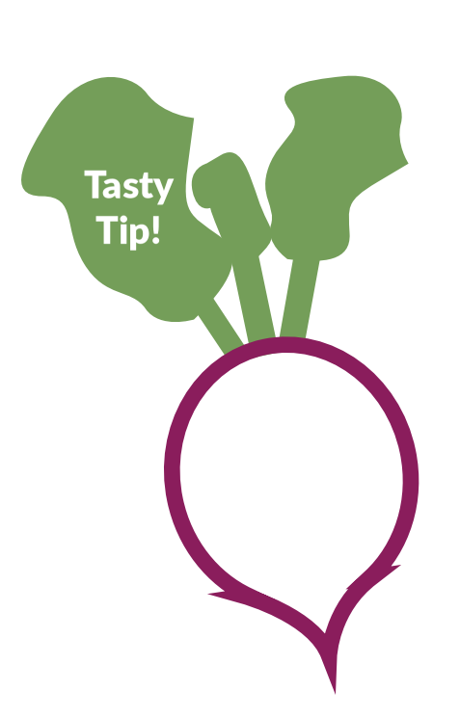
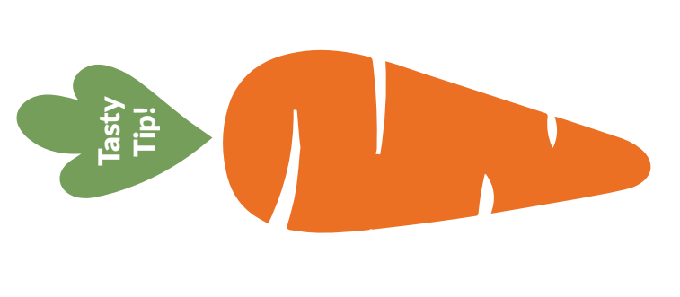
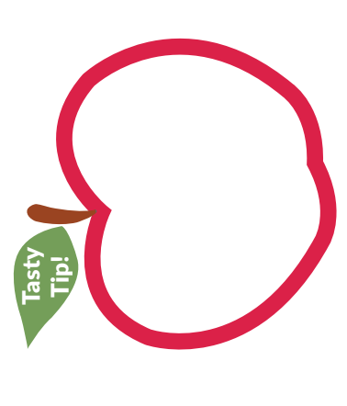
Tasty Tips
Whittier SDA Church
Notes:
In addition, you can use Tasty Tips to display at your distribution and you can find those in the take home packets. (but don't open those now) A tasty tip is a simple message to encourage people to use the pantry items at home. The message can be a common nutrition fact, a culinary tip or a new way to use new ingredients received at your pantry. The Tasty Tips have all been laminated, ready for you to use with a dry erase marker and they are easy to clean. The example shown on the right at Whittier SDA Church was used to let customers know that sweet potato contains Vitamin A and C and that it is good for your eyes!

Slide 12
Activity #1
Welcome to the AR Conference Food Distribution! As a Team you have been assigned the task to create fun and creative bundles for your clients to enjoy. Bundling is when you group together products to reduce waste and to give your customer’s ideas about how to cook the food at home.
Notes:
Now it's time for an activity to help you put Nudging and Bundling into practice. At your table you will find a large envelope (Nohemi shows the envelope). Here is the Activity Scenario: Welcome to the AR Conference Food Distribution! As a Team you have been assigned the task to create fun and creative bundles for your clients to enjoy. Bundling is when you group together products to reduce waste and to give your customer’s ideas about how to cook the food at home.

Slide 13
Instructions
In your packet you have delicious pantry items.
Review the instructions and create as many enticing bundles as you can!
1. | As a team, review the pantry items, instructions and Tasty Tips in your packet
2. | Lay out your images on the table
3. | Assign 1 person on your team to write down bundles on Page 2
4. | In addition, write up to 3 Tasty Tips to go with the bundles you created
5. | Your team will have 7 minutes to bundle items together
6. | Get creative with your bundles, spark conversations with your teammates and use your favorite recipes as inspiration
7. | Write all your bundles on the table provided on Page 2 before the time is up
8. | Good luck!
Notes:
In your packet you have delicious pantry items. Review the instructions and create as many enticing bundles as you can!
Step 1: As a team, review the pantry items, instructions and Tasty Tips in your packet (Nohemi pull out the instructions)
Step 2: Lay out your images on the table (Nohemi pull out some of the items)
Step 3: Assign 1 person on your team to write your bundles down on Page 2 (show Page 2 and pencil)
Step 4: In addition, write 3 Tasty Tips to go along with your bundles (show Tasty Tips)
Step 5: Your team will have 7 minutes to bundle items together
Step 6: Get creative with your bundles, spark conversations with your teammates and use your favorite recipes as inspiration
Step 7: Write all your bundles on the table provided on Page 2 before the time is up
Step 8: Good luck!

Slide 14
Get Ready, Get Set and…
BUNDLE!!!
Notes:
[Display list]
[Set timer for 7 minutes]
We will have some folks walk around in case you all have any questions.
You have 7 minutes on the clock. Get ready, get set, bundle!
Okay, the seven minutes are up. Can we have 3 tables volunteer to present their bundles and Tasty Tips?
[Give 8-10 minutes for report back]

Slide 15
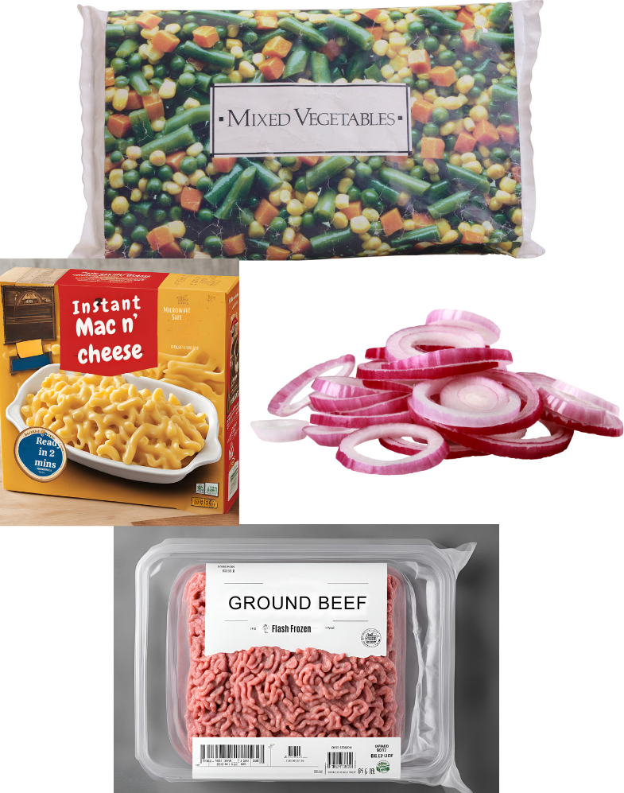
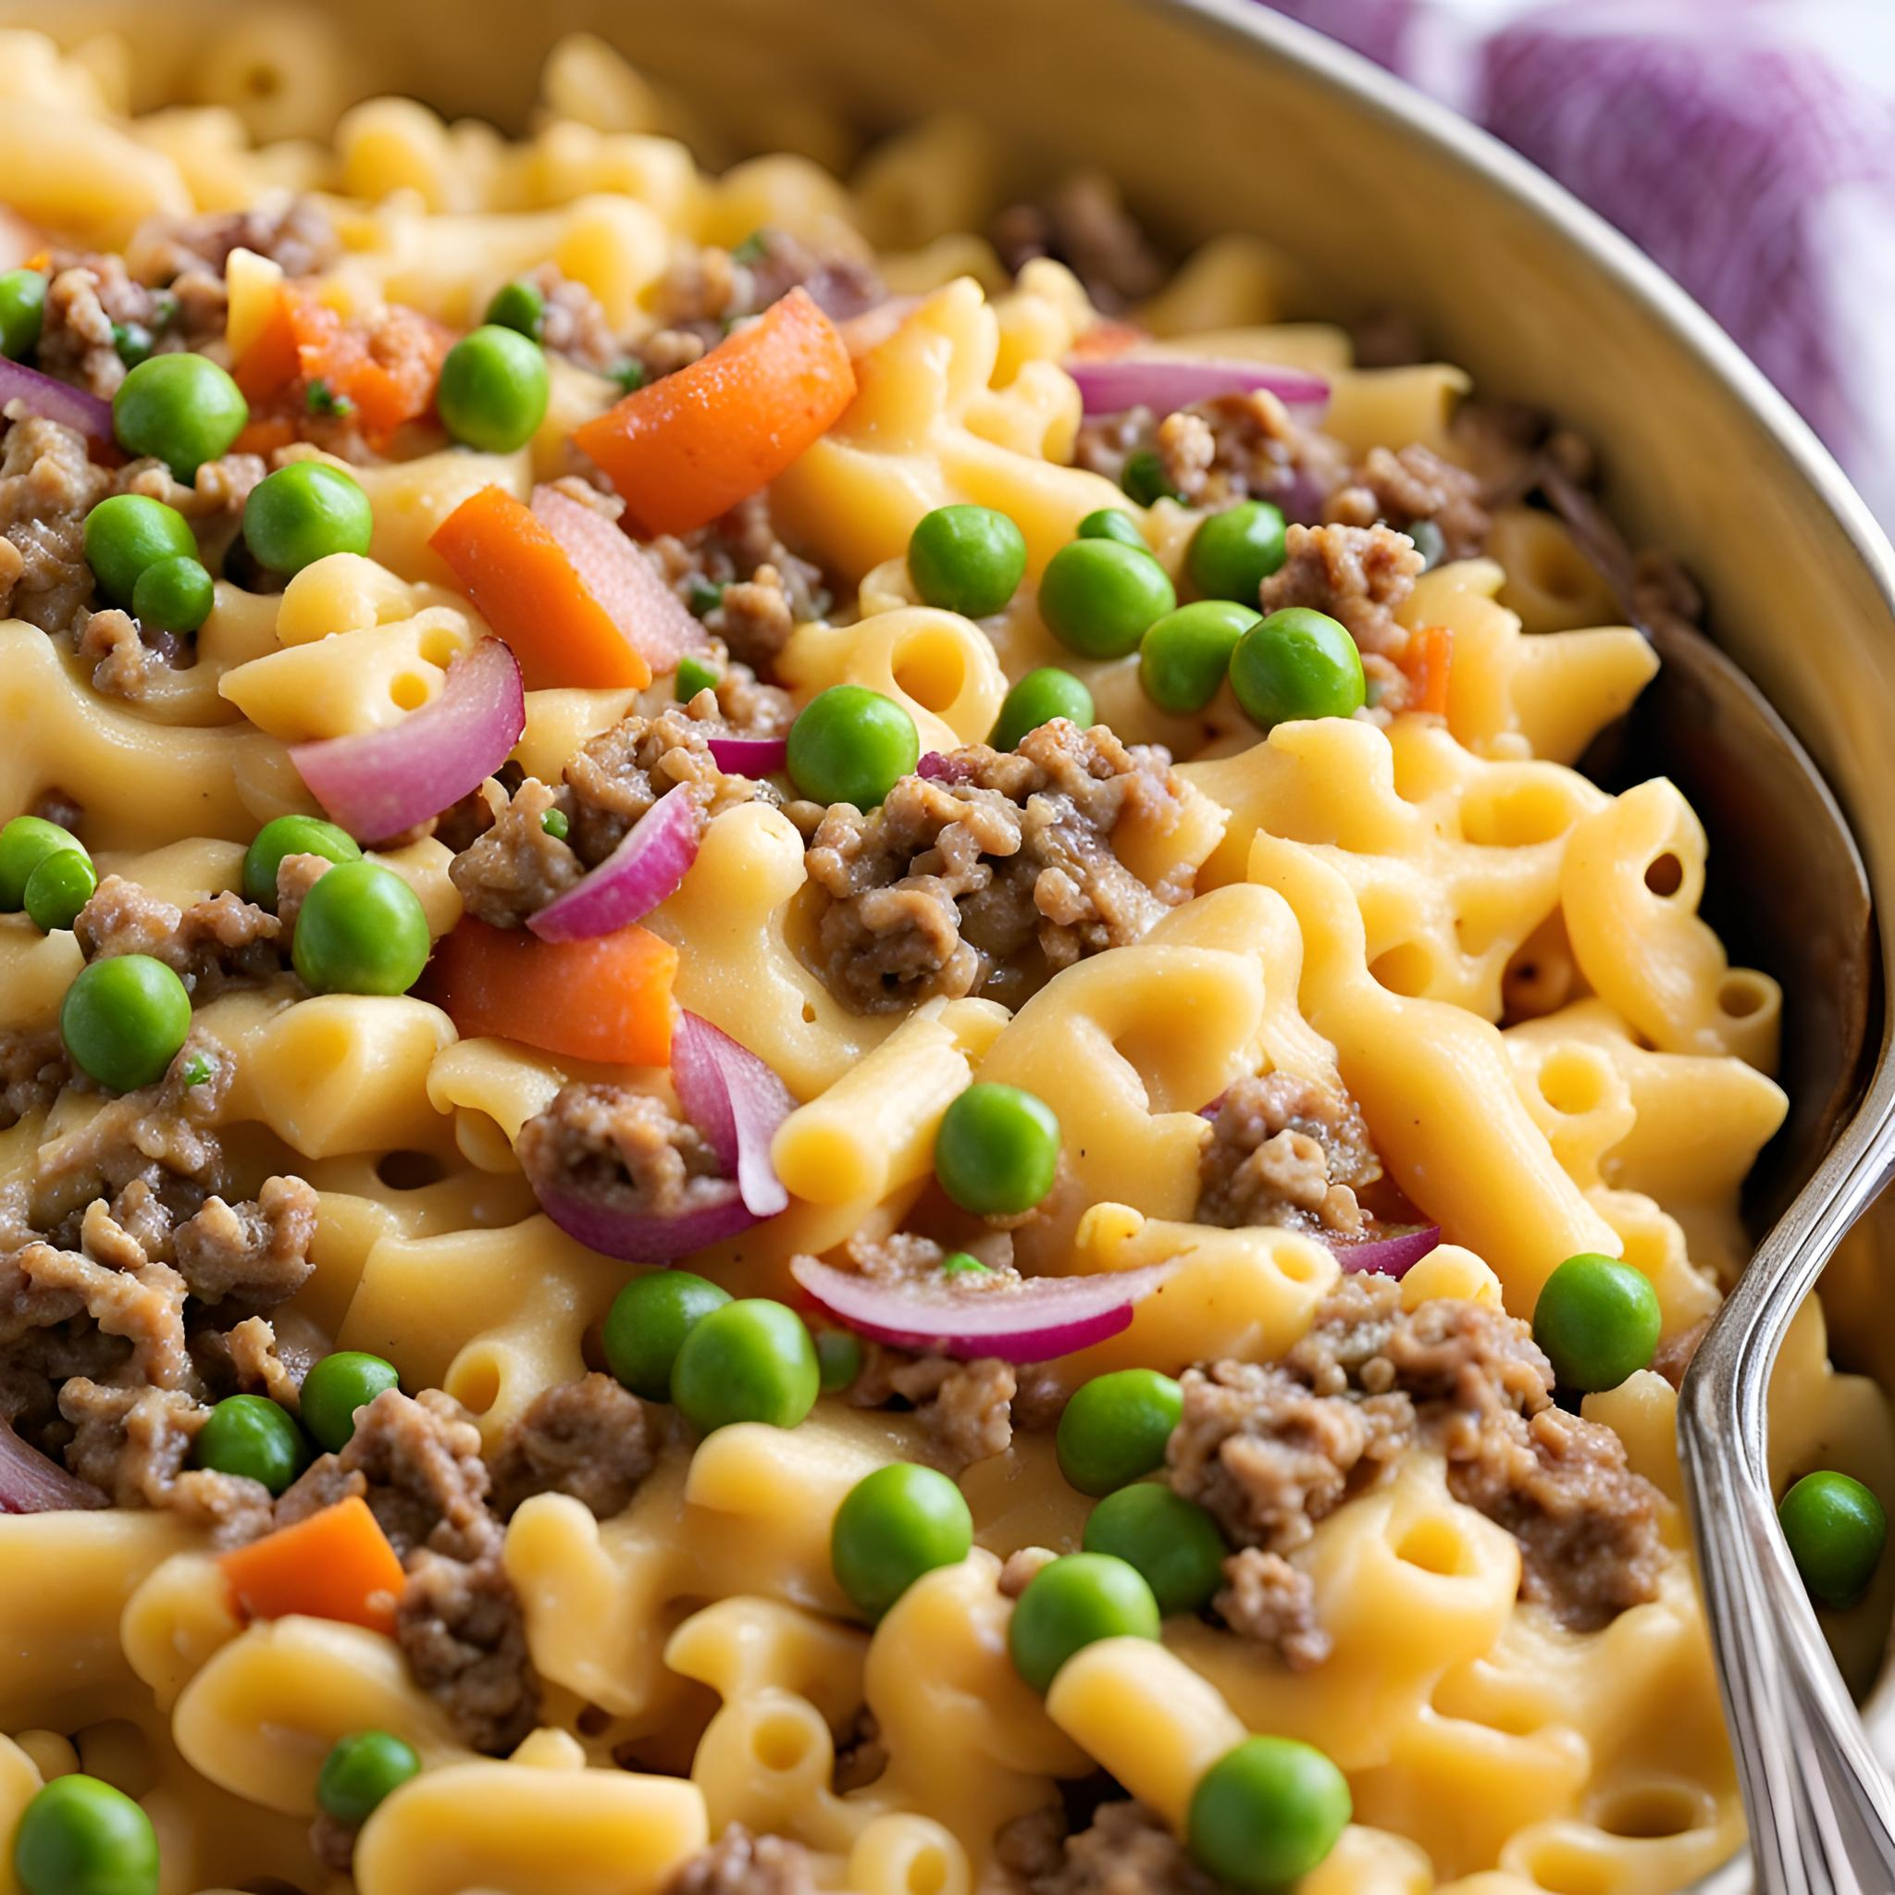
Tasty Tip 1: Add frozen peas and carrots to your Instant Mac n Cheese for more fiber and protein
Notes:
You all did a great job! Thank you to those who volunteered. We are going to show you some more examples of bundles we came up with:
Examples bundling suggestions, if more are needed:
Instant Mac n’ Cheese, ground beef, frozen mixed veggies and onions. (Tasty Tip: Add frozen peas and carrots to your Instant Mac n Cheese for more fiber and protein).
Expand - sometimes we don't always receive healthy items but here we ways we can make this instant mac and cheese more nutritious.

Slide 16
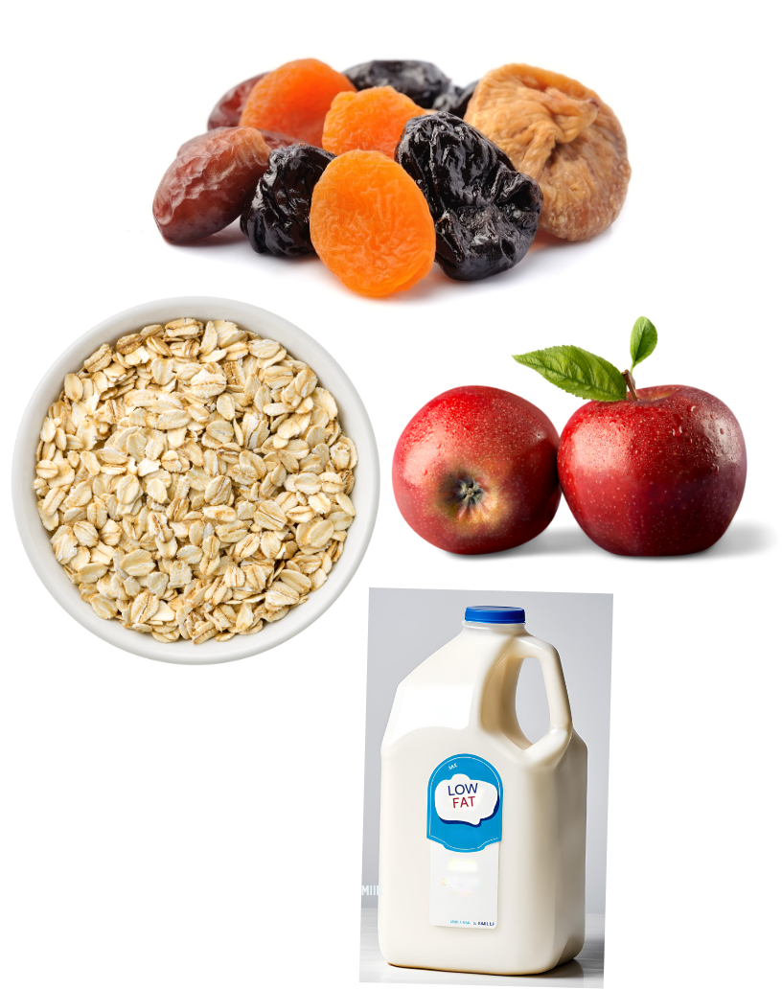
Tasty Tip 2: We go together for a filling breakfast!
Notes:
Rolled oats, milk, dried fruit and apples. (Tasty Tip: We go together for a filling breakfast).
Expand - Be creative and expand breakfast, lunch and dinner options. This is an example of a nutritious breakfast.

Slide 17
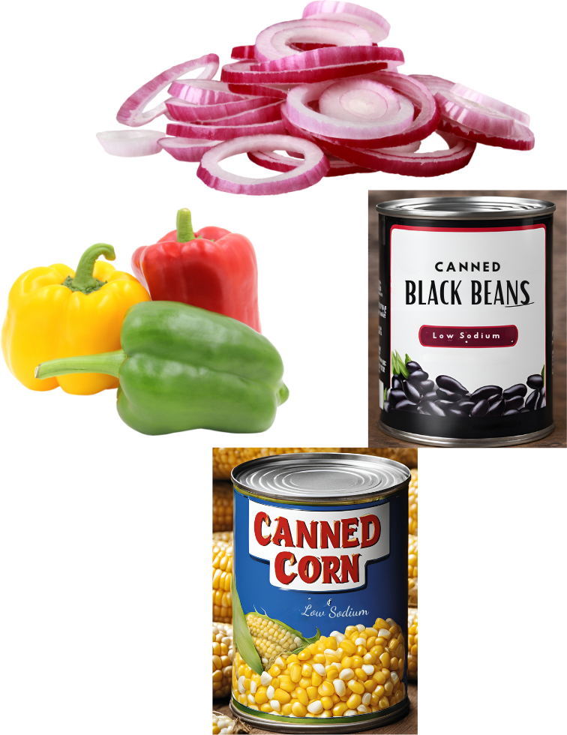
Tasty Tip 3: Just add fresh lime or cilantro for a quick salad. Rinsing canned foods reduces the sodium
Notes:
Canned beans, canned corn, onions, bell peppers. (Tasty Tip: Just add fresh lime juice and cilantro for a quick salad.
Expand - A helpful tip to give to your customers is to rinse your canned foods to reduce the sodium quantity.

Slide 18
Call to Action
The practice of nudging and bundling doesn’t have to be complicated. Use the Tasty Tips Cards in your take home packets to apply these practices at your next distribution.
Notes:
The practice of nudging and bundling doesn’t have to be complicated. Use the tasty tips cards in your take home packets to apply these practices at your next distribution.
(Tiffany, please leave to wash your hands)

Slide 19
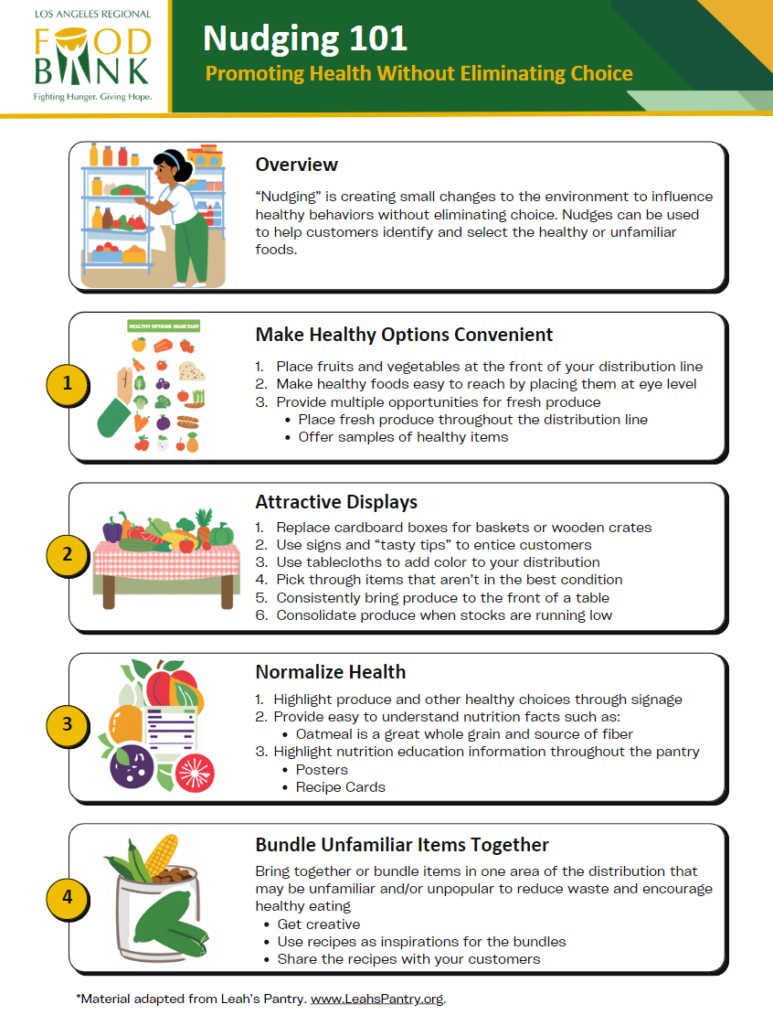
Best Practices
Notes:
To wrap up this section on Nudging and Bundling we want to give you some best practices to help you successfully execute bundles at your next distribution.
You will find a copy of this handout (point to screen) to use as a guide for you and your staff to help you apply Best Practices on nudging and bundling at your next distribution. It reiterates the points that were made throughout this presentation all in a helpful one pager!

Slide 20
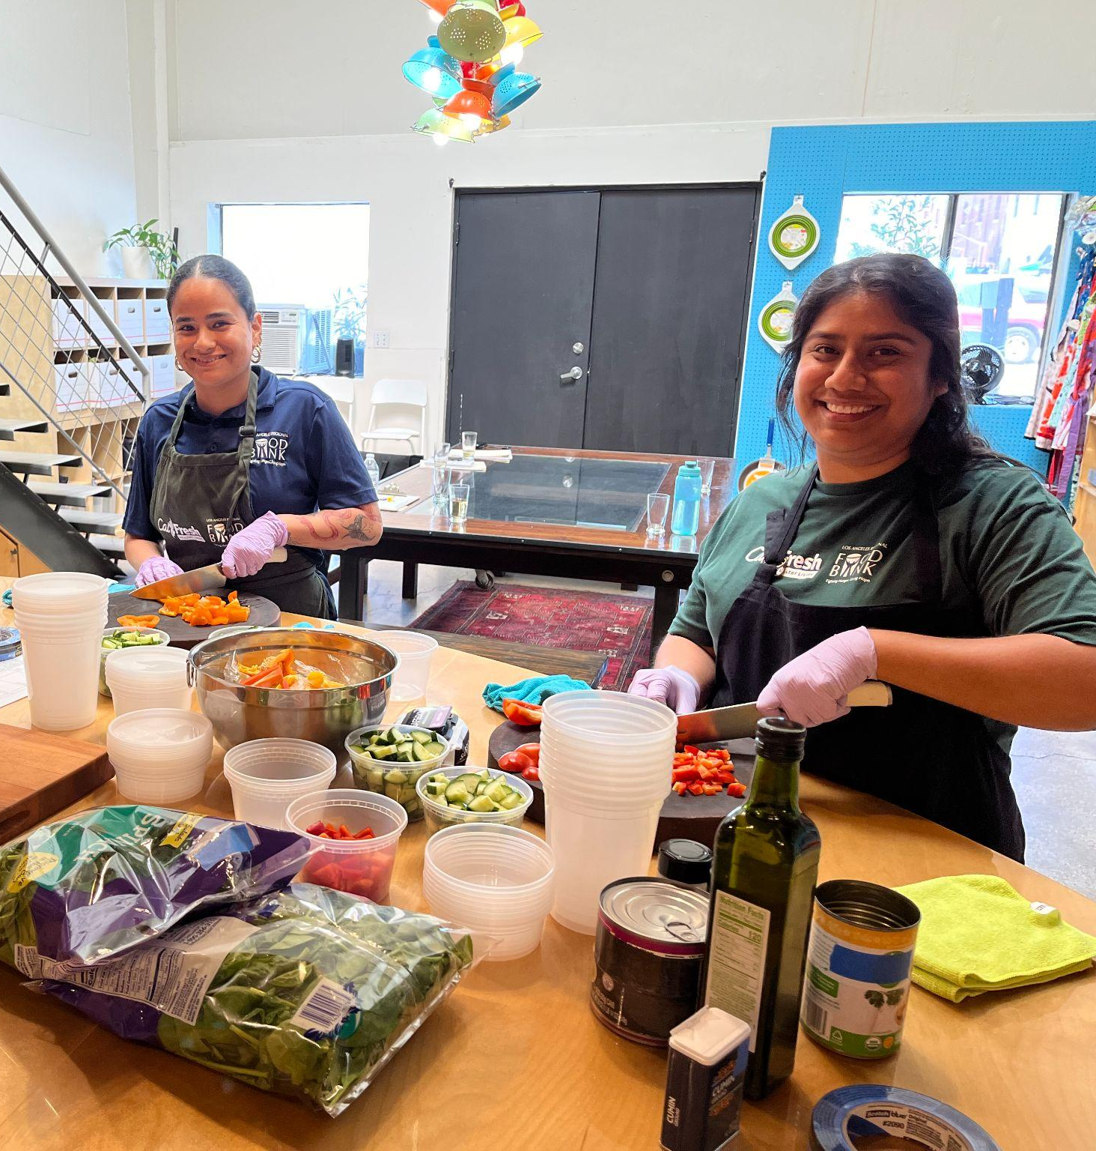
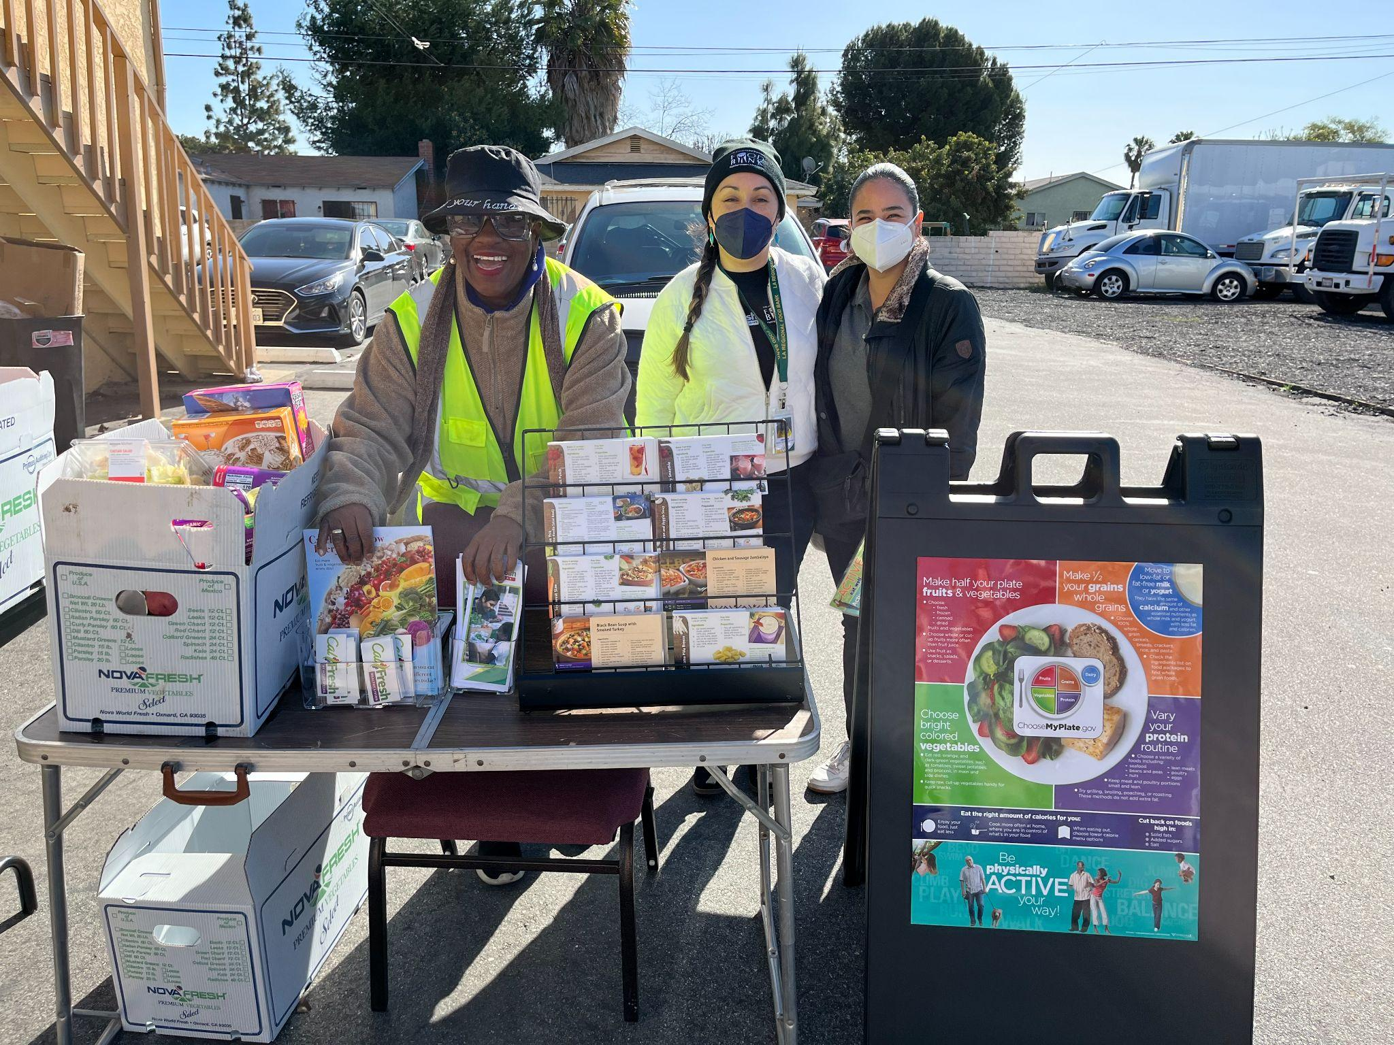
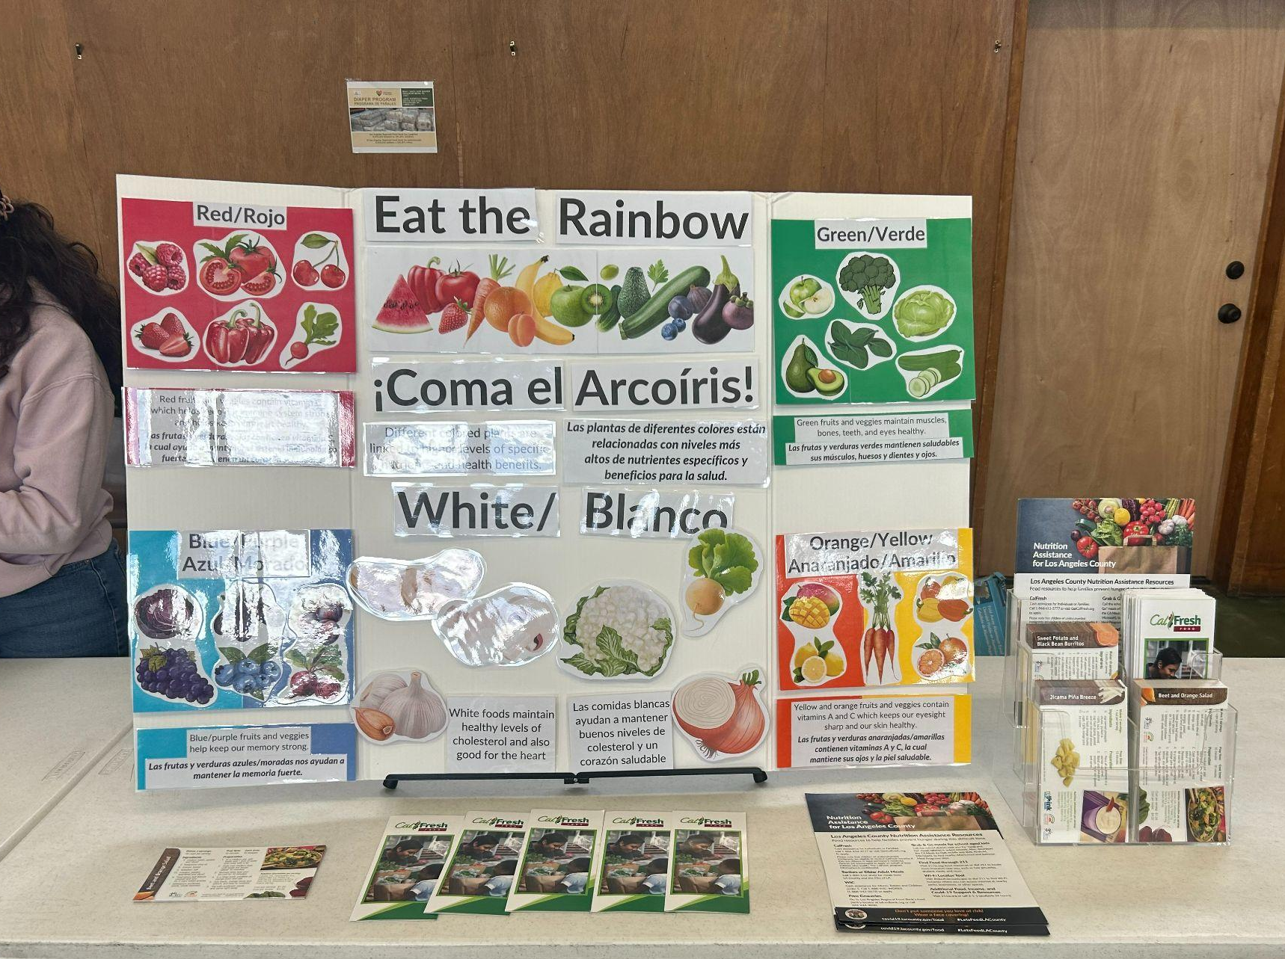
Nutrition Education
Informal Nutrition Education
Food Demos
Notes:
Now let’s talk about Nutrition Education.
There are two accessible ways of incorporating Nutrition Education at your pantry, which are informal NE, and Food Demonstrations. The easiest type to implement is Informal NE. You can put up healthy colorful posters (like we have displayed around the room) or you can even display recipe cards for customers to take home. Recipe cards and nutritional facts regarding food given out at your pantry can be found through websites like Eatfresh.org, Myplate.gov and foodhero.org.
The second type of Nutrition Education is Food Demonstrations. A food demonstration is showing a recipe or cooking skill to your customers. It can be as simple as highlighting a single ingredient to give out during your distribution or it can be creating an infused water from scratch using pantry items. We will be conducting an infused water demonstration to show another way to elevate the pantry experience.

Slide 21
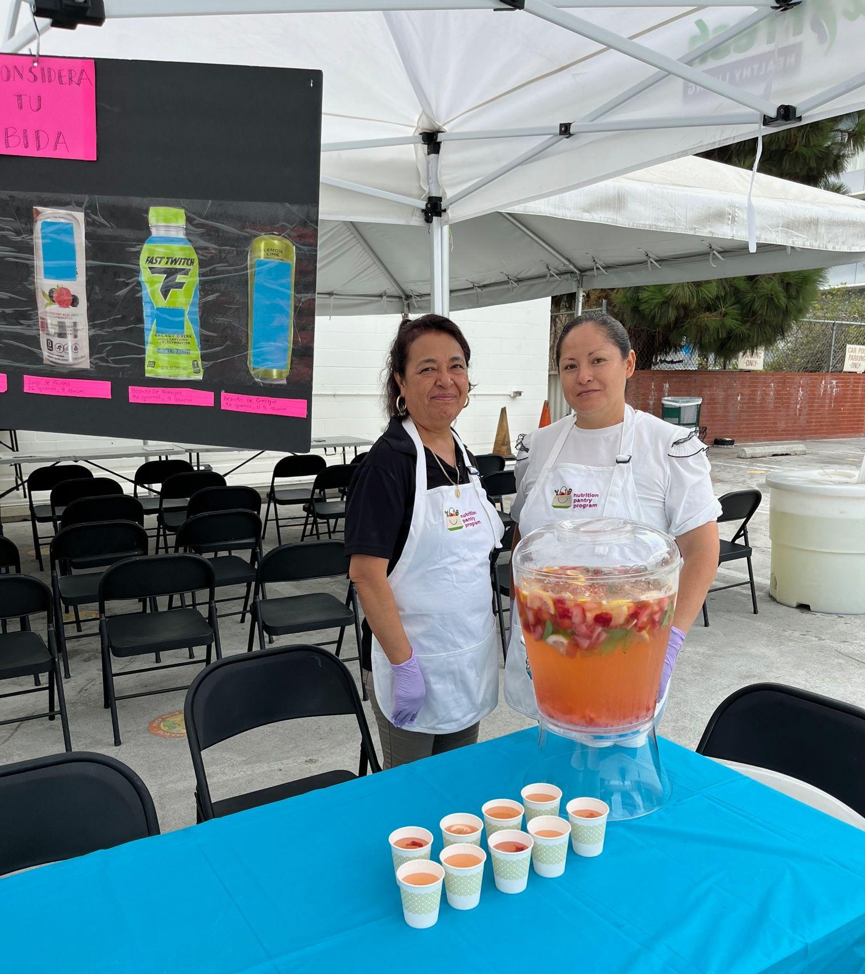
Rethink Your Drink
Rethink your Drink is a great way to highlight choosing a healthy sugar-free beverage by infusing water with fun natural flavors and color!
Central City Neighborhood Partners
Notes:
For this activity, we are going to conduct an infused water demonstartion also known as Rethink Your Drink food demo based on two different common pantry items received at distributions. Frozen Strawberries and Cucumbers.
Rethink Your drink is one of the simplest food demos to implement at your pantry. All you need is a pitcher, water and your favorite fruit, vegetable and/or herbs. You can make a recipe based on the produce received in the distribution and highlight them in an easy recipe. Rethink Your Drinks are great because you can choose a variety of flavor combinations and teach the valuable nutrition lesson of choosing water over sugary drinks.

Slide 22
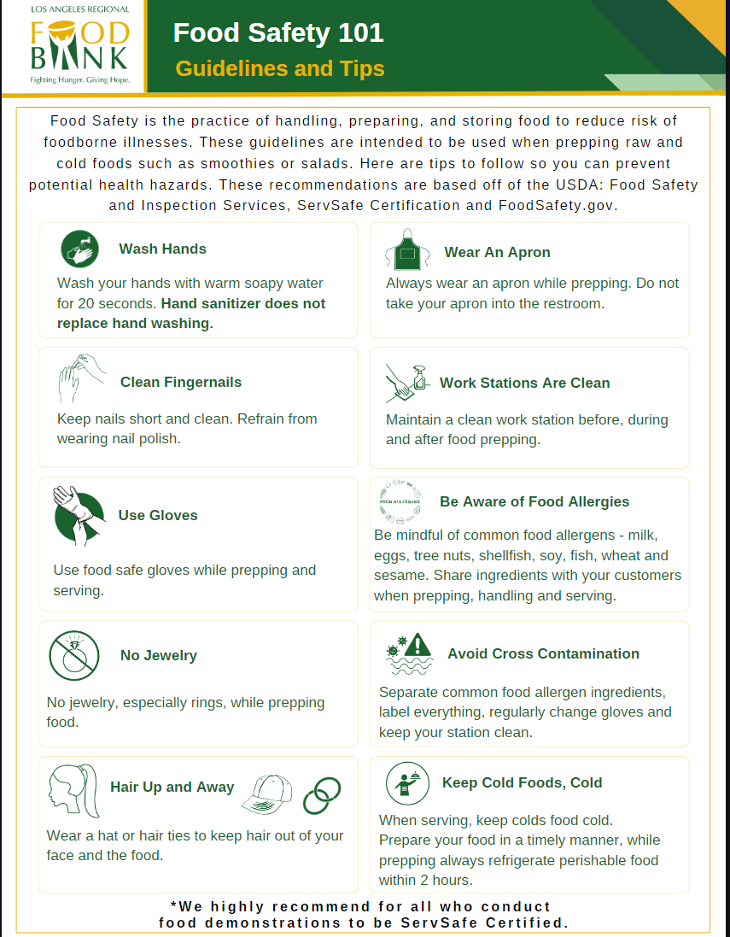
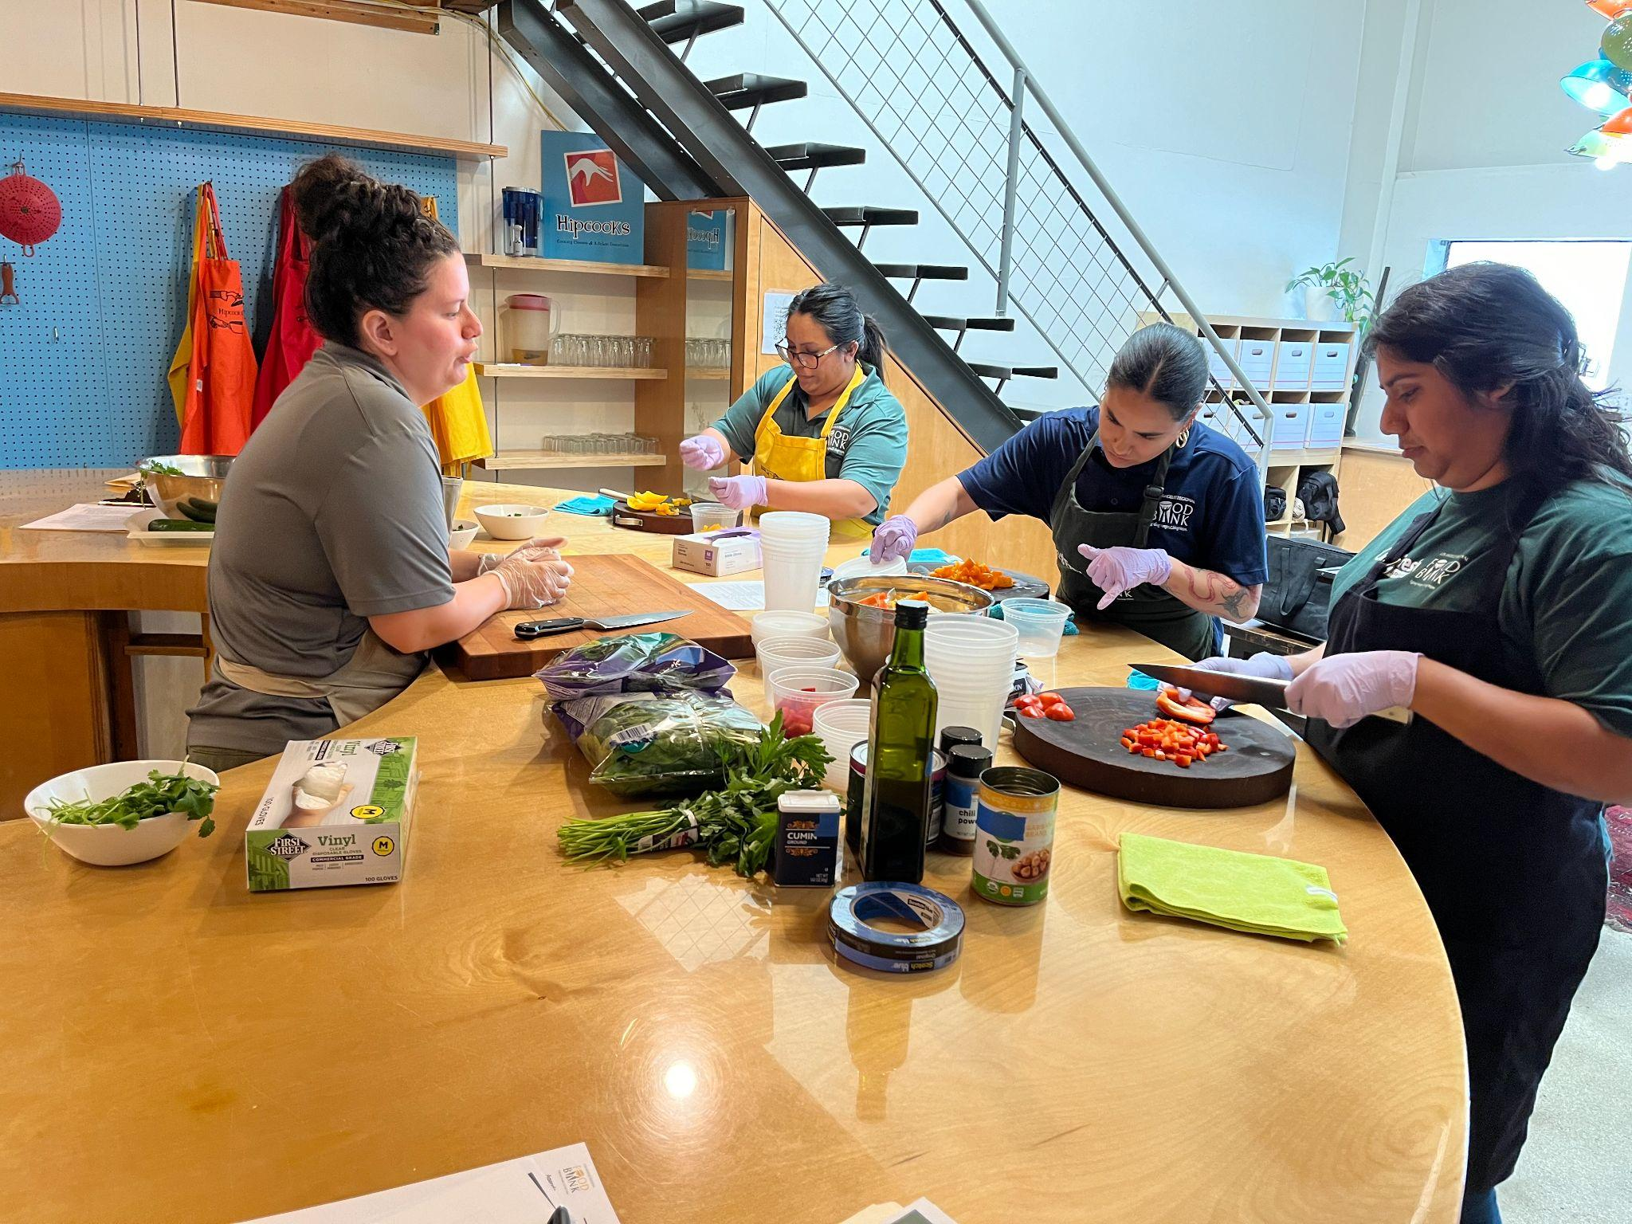
Food Demo: Best Practices
Notes:
I will go over Activity 2 and all the Steps to conduct a successful Rethink Your Drink while Tiffany conducts the demonstration. We take food safety at the Food Bank very seriously. Food Safety is the practice of handling, preparing, and storing food to reduce risk of foodborne illnesses. We highly recommend all who want to implement food demos to practice proper food safety protocols and to become ServSafe certified. Tiffany left after her portion of the presentation to practice proper food safety protocols. She washed her hands for 20 seconds with warm soapy water. She will then sanitize her hands and put on single use food safe gloves. Hand sanitizer does not replace hand washing. On the screen and in your take home packets you will find this infographic (point to screen) that goes over 10 tips for proper Food Safety handling. The infographic was gathered based on information from the USDA, ServSafe and FoodSafety.gov.

Slide 23
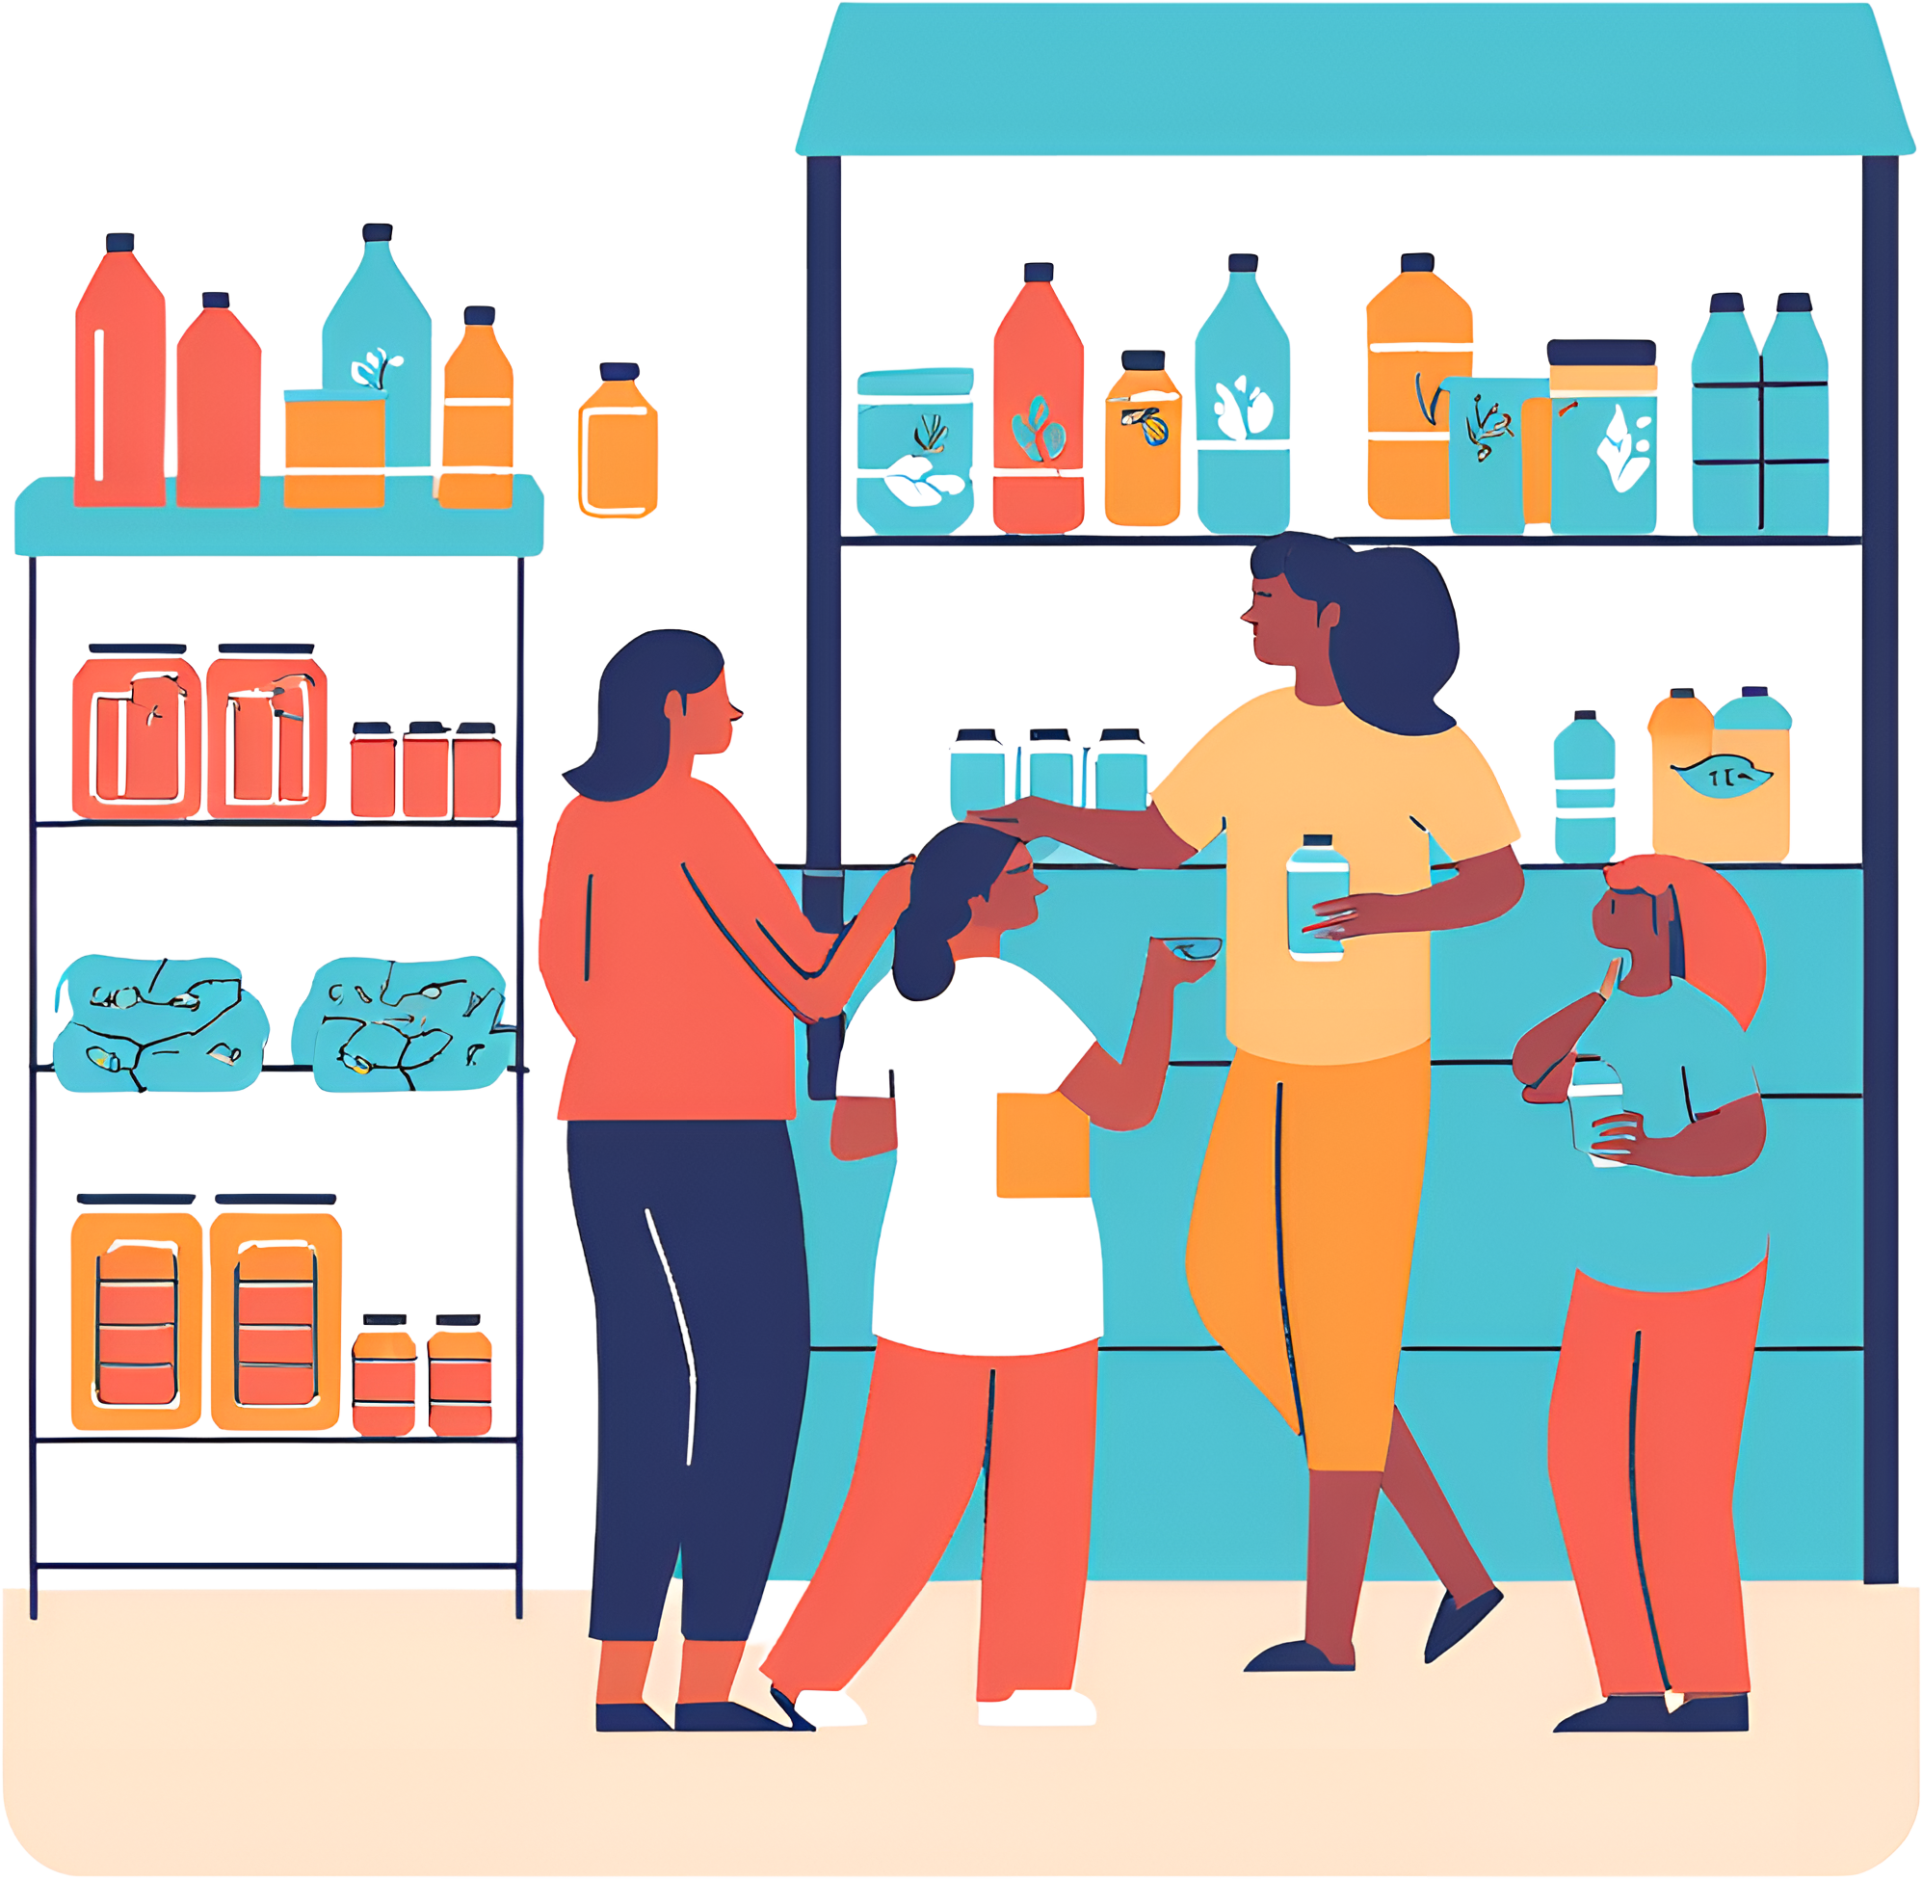
Activity #2
It is a hot day at the AR Conference Food Distribution. We want to make sure that our customers and neighbors stay cool and can enjoy a refreshing beverage. Our Health Educator Tiffany is going to conduct a Rethink Your Drink Demonstration for you all to observe and enjoy.
Notes:
Now it's time for Activity 2. At your table you will find a second large envelope (Nohemi shows the envelope). Here is the Activity 2 Scenario: It is a hot day at the AR Conference Food Distribution. We want to make sure that our customers and neighbors stay cool and can enjoy a refreshing beverage. Our Health Educator Tiffany is going to conduct a Rethink Your Drink Demonstration for you all to observe and enjoy.

Slide 24
Instructions
In your packets are laminated recipe cards. Review the instructions and recipe cards. Enjoy the Rethink Your Drink Demonstration!
1. | Take out the Recipe Card in the Activity 2 Packet
2. | There will be 1 laminated card per table
3. | Review the recipe while Tiffany conducts the Food Demonstration
4. | Please return the recipe card after the demonstration
5. | Enjoy your infused water!
Notes:
In your packets is a laminated recipe card. Review the instructions and recipe card. Enjoy the Rethink Your Drink Demonstration!

Slide 25
Step 1
Review the Rethink Your Drink Recipe, go over the ingredients with your customers and make sure your work station is clean
Notes:
Now we can start the food demo:
There is a laminated copy of the recipe we will be making today on your table, please return the recipe card into the packet once we are done with the demo
Step 1: Review the recipe , go over the ingredients with your customers and make sure your work station is clean
This recipe contains cucumbers and frozen strawberries
We keep each ingredient in separate containers during our preparation to avoid cross contamination
If you are allergic to either ingredient we recommend for you to not try the sample we will provide at the end of the activity

Slide 26
Step 2
Have a clean pitcher and water
Notes:
Step 2: Have a clean pitcher and water
Tiffany is highlighting the importance of having a clean work station as you are preparing your food demonstration

Slide 27
Step 3
Add your cucumbers and frozen strawberries
Notes:
Step 3: Add your cucumbers and frozen strawberries
During a Rethink Your Drink demonstration you can provide nutrition facts as you are making your delicious water
For example talk up the frozen strawberries your customers will get at the distribution
Did you know that frozen strawberries are rich in Vitamin C and have almost as much Vitamin C as an orange?

Slide 28
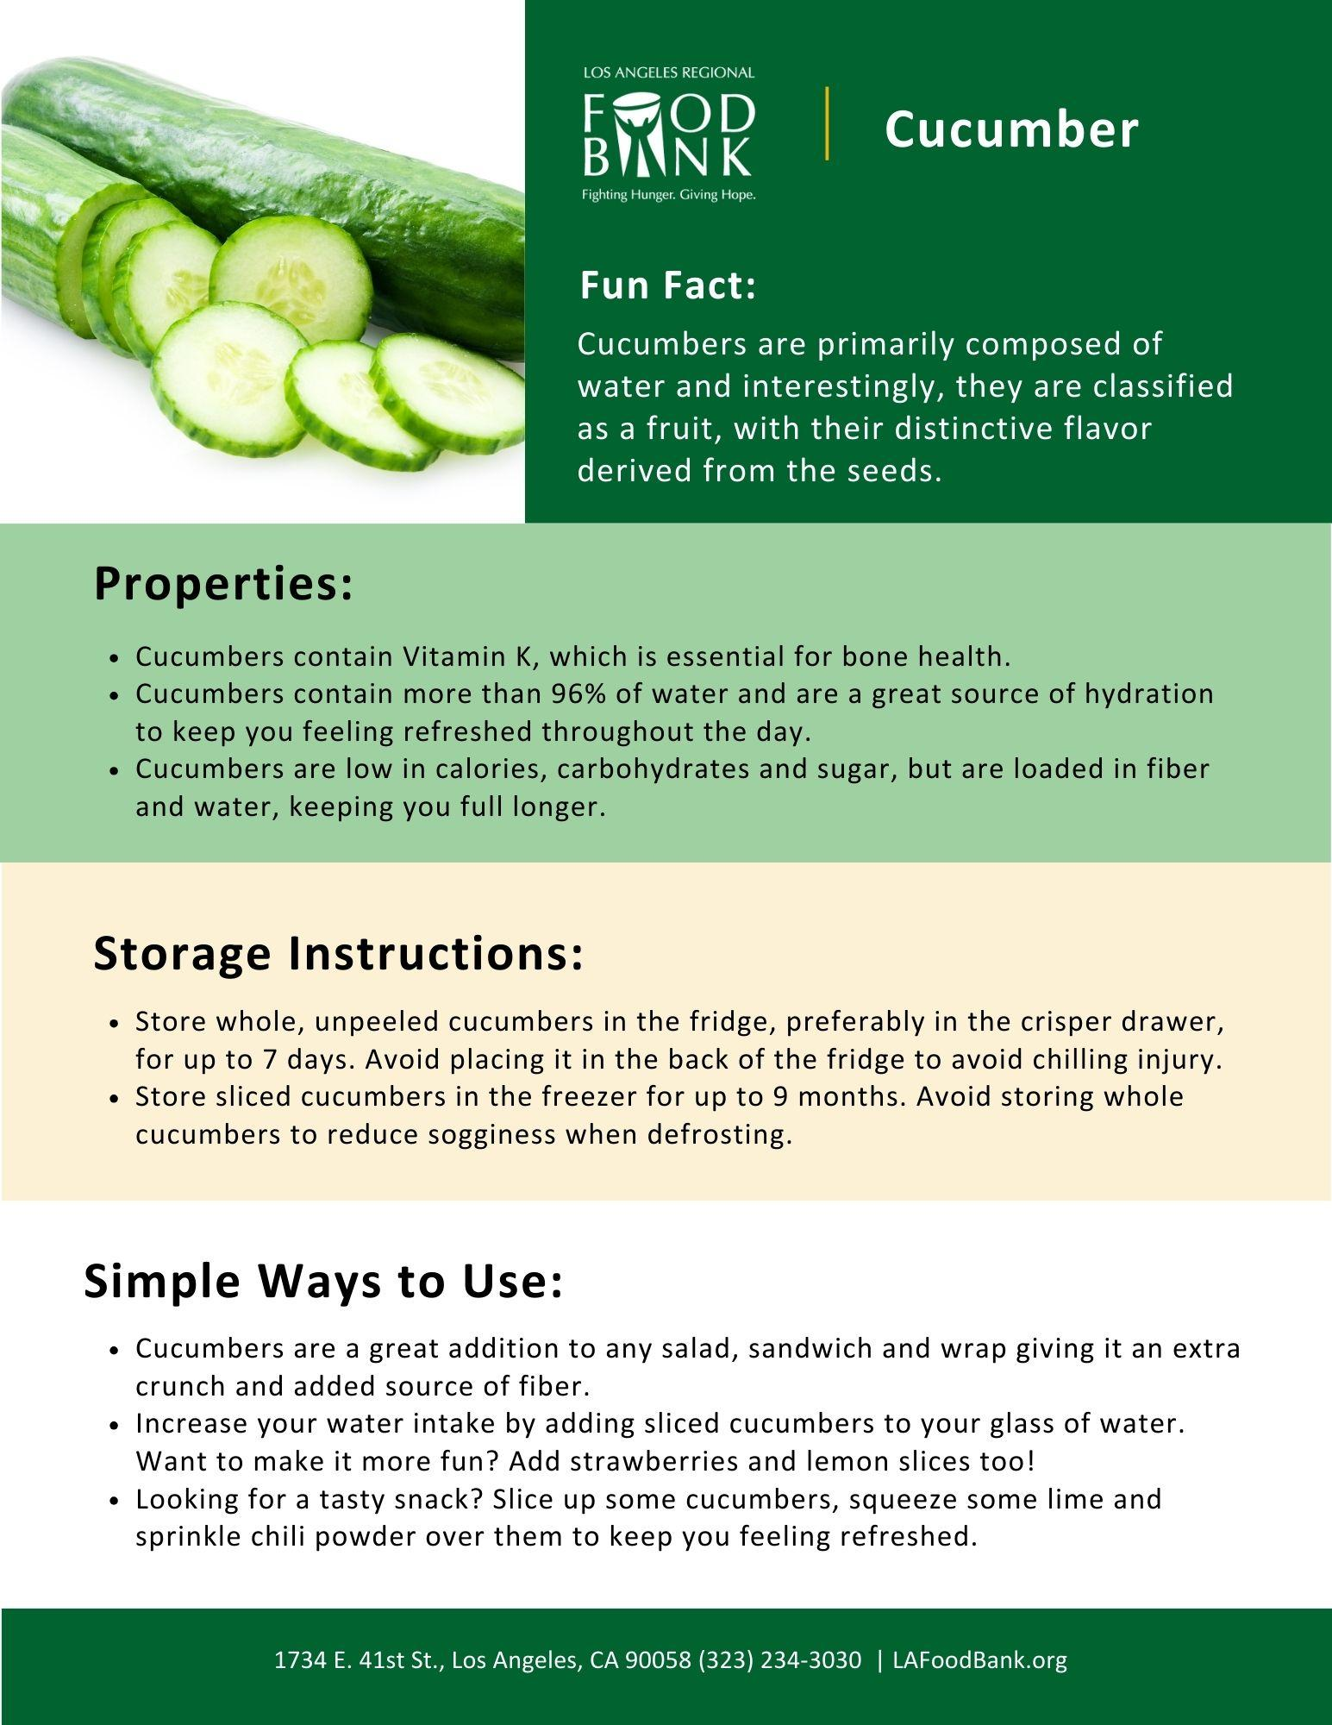
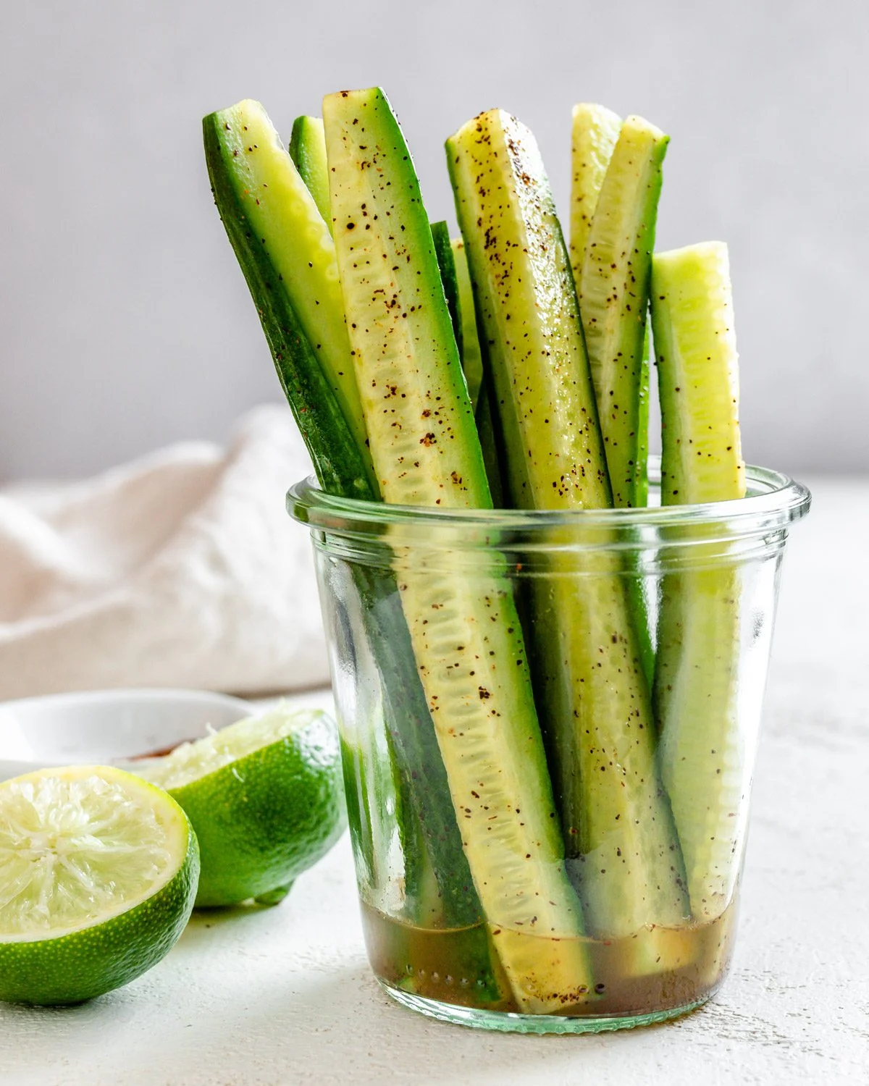
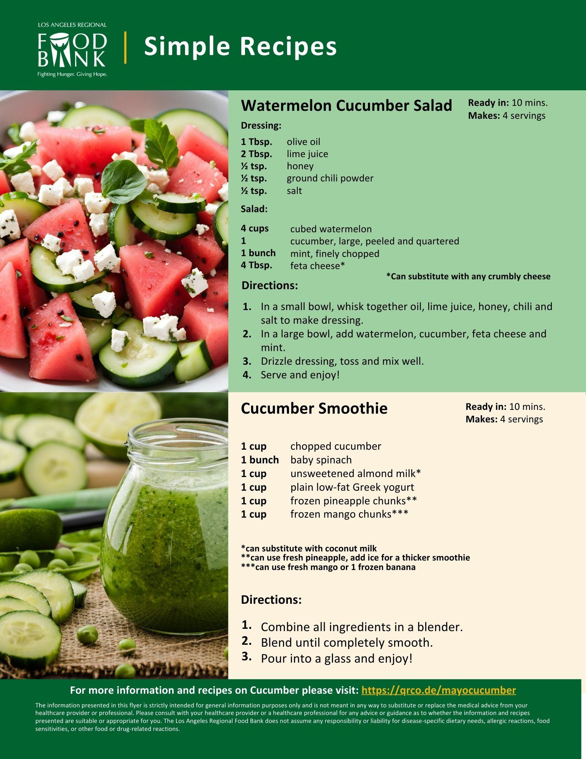
Bonus: Single Ingredient
Notes:
As a bonus, If you didn’t want to make a Rethink Your Drink recipe you can highlight either the strawberries or the cucumbers and do a single ingredient demo
For example cut up cucumbers and pass them out in sample cups to your customers as they wait in line
Tiffany is safely cutting the cucumbers into small pieces that are easy for people to try.
Again you can share a nutrition fact as well like cucumbers are great for hydration and contain fiber when you eat the skin
In your take home packets you will receive nutritional information regarding cucumbers along with simple to make recipes highlighting this ingredient. As an added bonus, you will receive one for strawberries as well!
Both are in English and Spanish.

Slide 29
Step 4
Allow the ingredients to infuse for at least 20 minutes
Notes:
Step 4: Allow the ingredients to infuse for at least 20 minutes
You can also let it sit overnight, especially if you peel the skin off of the cucumbers

Slide 30
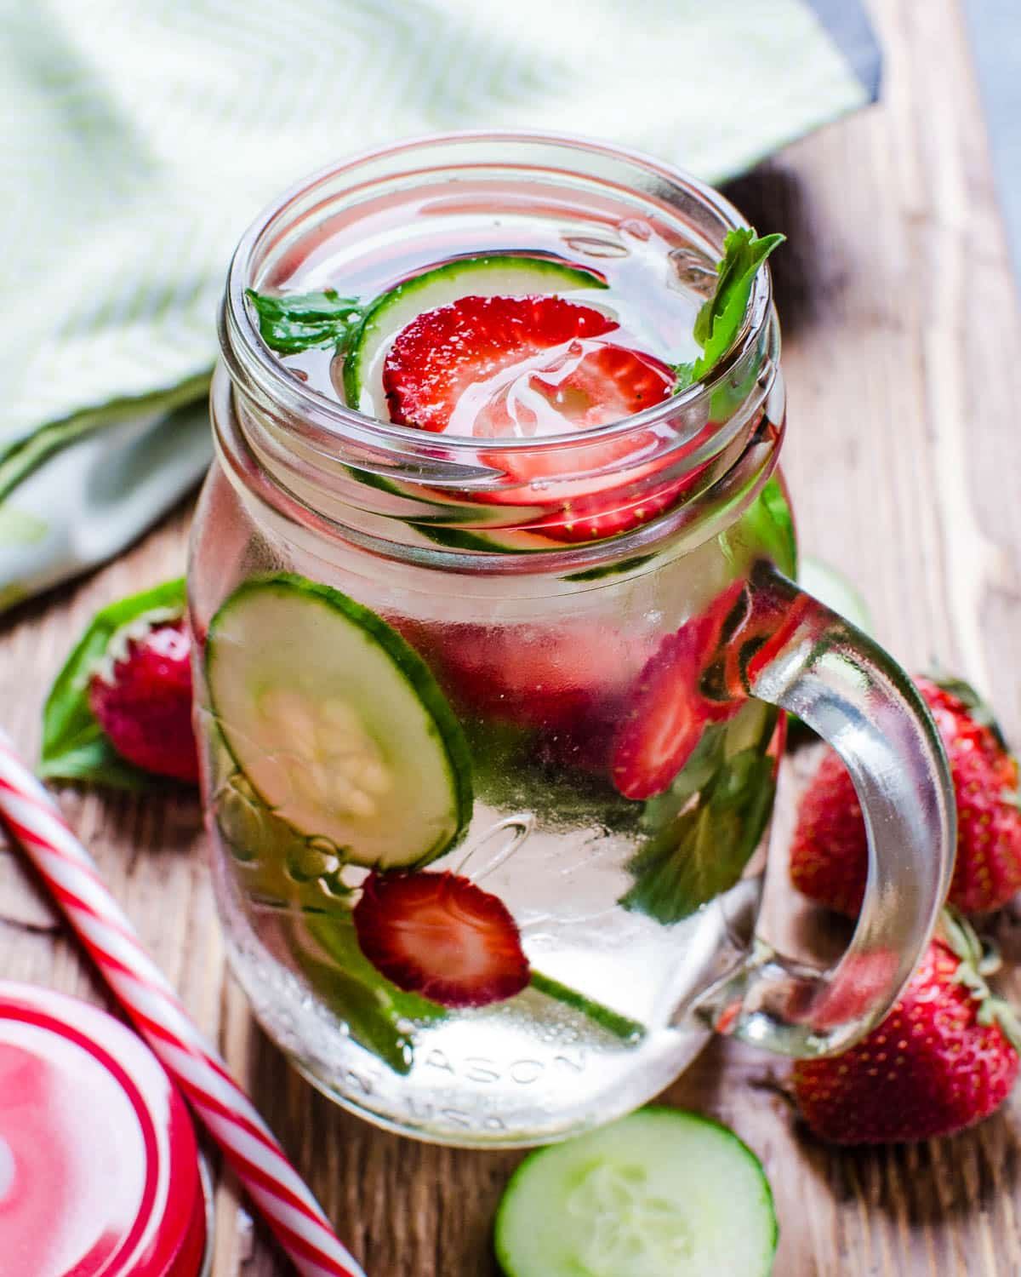
Step 5
Serve and Enjoy!
Notes:
Step 5: Serve and enjoy!
You can pass out the samples to your customers as they wait in line for their food, especially on a hot day
You can take the extra step and provide a recipe to go along with the sample or ingredient
A great online resource to look up healthy recipes is EatFresh.org

Slide 31
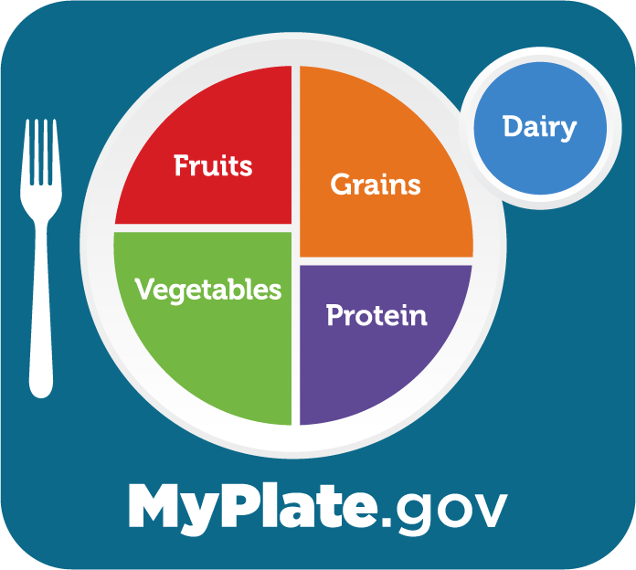
Other Resources
eatfresh.org
USDA.gov
Myplate.gov
CalFreshHealthyLiving.org
Foodsafety.gov
Commonthreads.org
Notes:
Here is a list of reputable resources where you can find nutrition education information, food safety guidance and easy to make nutritious recipes you can share with your customers.
I encourage you all to take a minute to take a picture of this screen so that you can use it on your own.

Slide 32
Keep It Simple
Rethink Your Drink Recipe Idea Table
Materials Needed: |  |  | Ingredients:
Water | Sparkling Water | Cutting Board | Favorite Fresh Fruit or Veggies | Lemons, Limes, Oranges, Cucumbers, Apples, etc.
Pitcher | Gloves | Knife | Favorite Frozen Fruit | Berries, Peaches, Strawberries, Mangos, etc.
Ice | Cups | Refrigerator | Favorite Fresh Herbs and Spices | Mint, Basil, Cinnamon, Rosemary, Sage, Thyme
Notes:
In addition, here is the same table found on your Activity 2 Instructions. They are the basic ingredients and items you would need to conduct a Rethink Your Drink Demo. Remember don’t stress, only conduct a demonstration if you have the capacity as a pantry and have fun with it. Which leads to our final call to action.

Slide 33
Call to Action
Food demos are a fun way to engage with your community and provide a service that your customers can consume right away. They don’t need to be expensive, time consuming or complicated for your customers to enjoy it.
Notes:
Food demos are a fun way to engage with your community and provide a service that your customers can consume right away. They don’t need to be expensive, time consuming or complicated for your customers to enjoy it.

Slide 34
Notes:
We want to continue to improve as a department. We value and appreciate your feedback. Please take the time to scan the QR Code on the presentation screen to answer a few questions. For those of you who are not familiar with QR codes, simply open the camera on your phone and hover over the image and click on the link that pops out below.

Slide 35
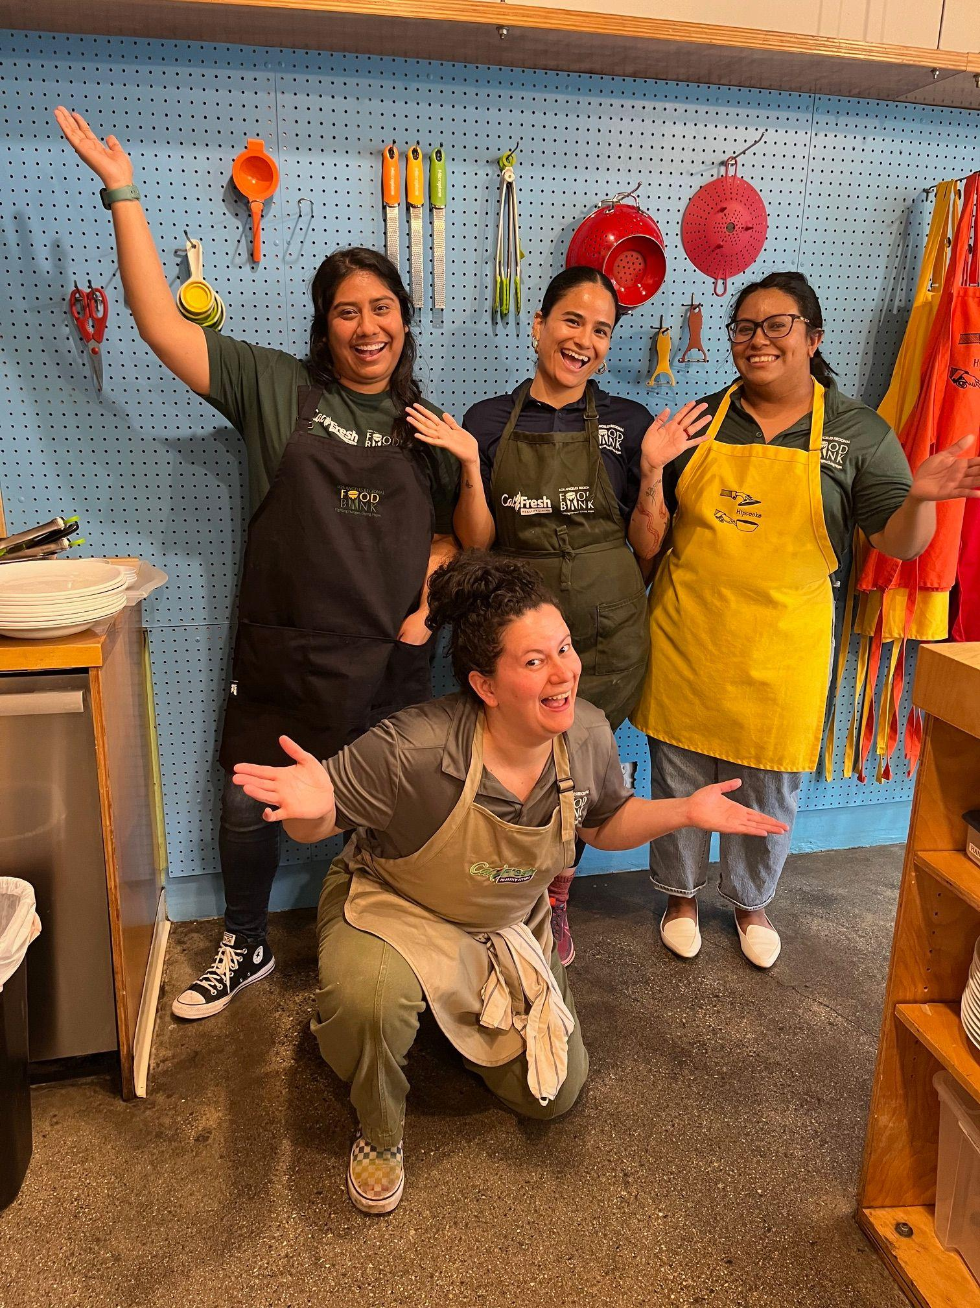
Questions?
Notes:
Our team will pass out the samples. In the meantime, does anyone have any questions for the remainder of our time together?

Slide 36
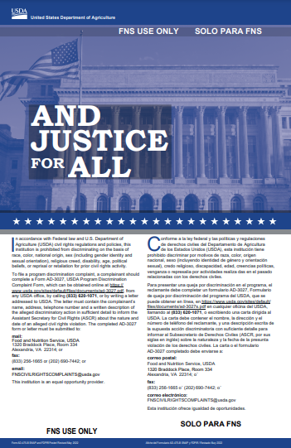
Thank You
Funded by USDA SNAP, an equal opportunity provider. Visit www.CalFreshHealthyLiving.org for healthy tips.
Material adapted from Leah’s Pantry. www.LeahsPantry.org.
Notes:
Show and skip.

Slide 37
Nutrition Services Team
Contact Information:
(323) 695-5538
nutritionservices@lafoodbank.org
1734 E 41st St
Los Angeles, CA 90058
Notes:
Thank you for your dedication to serving communities in need. We look forward to seeing you all next year!

